Slide 1

C1 Discriminants (for Year 11s)
Dr J Frost (jfrost@tiffin.kingston.sch.uk)
Objectives: Understand the conditions under which a quadratic equation has no, equal or distinct roots.
Last modified: 23rd August 2015

Slide 2
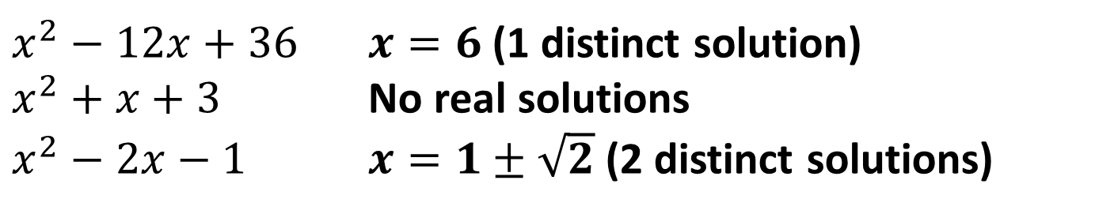
STARTER
How many distinct real solutions do each of the following have?
$x^{2}−12x+36$ $x=6$ (1 distinct solution)
$x^{2}+x+3$ No real solutions
$x^{2}−2x−1$ $x=1±\sqrt{2}$ (2 distinct solutions)
?
?
?

Slide 3
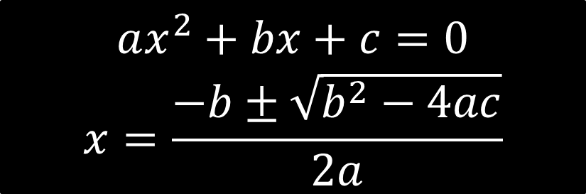
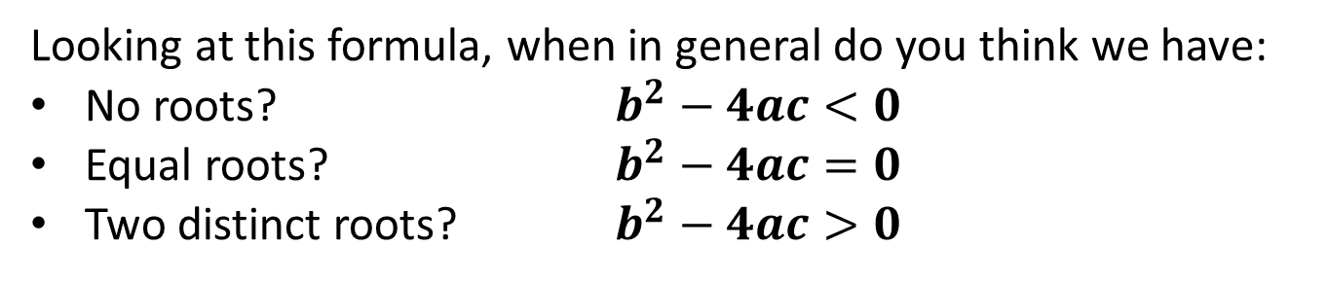
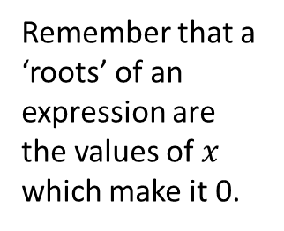

The Discriminant
$$ax^{2}+bx+c=0$$
$$x=\frac{−b±\sqrt{b^{2}−4ac}}{2a}$$
Remember that a ‘roots’ of an expression are the values of $x$ which make it 0.
Looking at this formula, when in general do you think we have:
No roots? $b^{2}−4ac<0$
Equal roots? $b^{2}−4ac=0$
Two distinct roots? $b^{2}−4ac>0$
?
?
!
?
$b2 – 4ac$is known as the discriminant.

Slide 4


















The Discriminant
Equation
Discriminant
Number of Roots
$$x^{2}+3x+4$$
?
?
$$−7$$
$$0$$
?
?
$$x^{2}−4x+1$$
$$12$$
$$2$$
?
?
$$x^{2}−4x+4$$
$$0$$
$$1$$
?
?
$$2x^{2}−6x−3$$
$$60$$
$$2$$
?
?
$$x−4−3x^{2}$$
$$−47$$
$$0$$
$$1−x^{2}$$
?
?
$$4$$
$$2$$

Slide 5
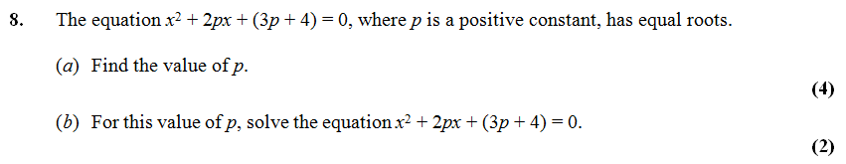



Problems involving the discriminant
?
?
?
a) $a=1, b=2p, c=3p+4$
$${\left(2p\right)}^{2}−4\left(1\right)\left(3p+4\right)=0 \\ 4p^{2}−12p−16=0 \\ p^{2}−3p−4=0 \\ \left(p+1\right)\left(p−4\right)=0 \\ p=4$$
Bro Tip: Always start by writing out $a, b$ and $c$ explicitly.
?
b) When $p=4$: $x^{2}+8x+16=0$
$${\left(x+4\right)}^{2}=0, x=−4$$
?

Slide 6

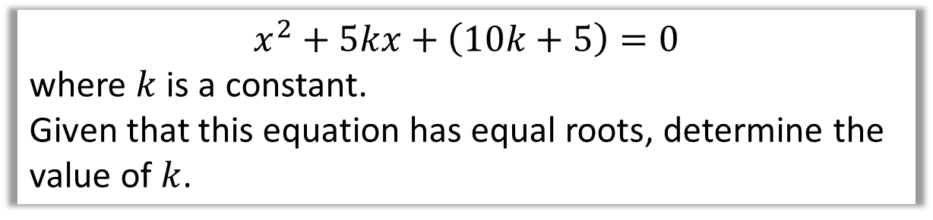
Test Your Understanding
$$x^{2}+5kx+\left(10k+5\right)=0$$
where $k$ is a constant.
Given that this equation has equal roots, determine the value of $k$.
?
$$a=1, b=5k, c=10k+5 \\ {\left(5k\right)}^{2}−4\left(1\right)\left(10k+5\right)=0 \\ 25k^{2}−40k−20=0 \\ 5k^{2}−8k−4=0 \\ \left(5k+2\right)\left(k−2\right)=0 \\ k=2$$

Slide 7
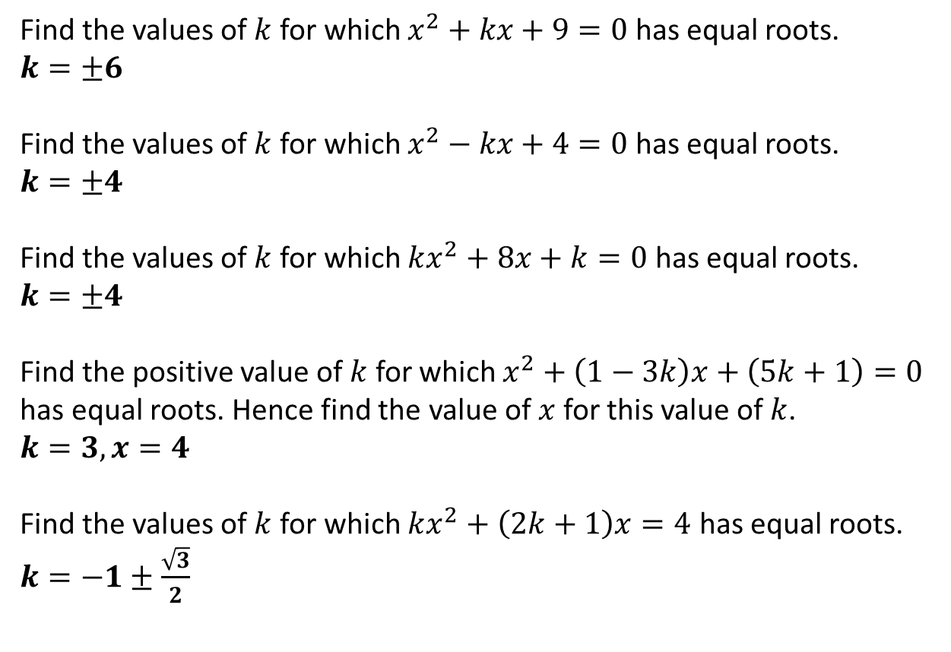
Exercises
1
Find the values of $k$ for which $x^{2}+kx+9=0$ has equal roots.
$k=±6$
Find the values of $k$ for which $x^{2}−kx+4=0$ has equal roots.
$k=±4$
Find the values of $k$ for which $kx^{2}+8x+k=0$ has equal roots.
$k=±4$
Find the positive value of $k$ for which $x^{2}+\left(1−3k\right)x+\left(5k+1\right)=0$ has equal roots. Hence find the value of $x$ for this value of $k$.
$k=3, x=4$
Find the values of $k$ for which $kx^{2}+\left(2k+1\right)x=4$ has equal roots.
$k=−1±\frac{\sqrt{3}}{2}$
?
2
?
3
?
4
?
5
?
We’ll revisit this topic after we’ve done Inequalities.

