Slide 1

IGCSE Further Maths/C1 Inequalities
Dr J Frost (jfrost@tiffin.kingston.sch.uk)
Objectives: Be able to solve both linear and quadratic inequalities. Be able to manipulate inequalities (including squared terms).
Last modified: 20th March 2016

Slide 2



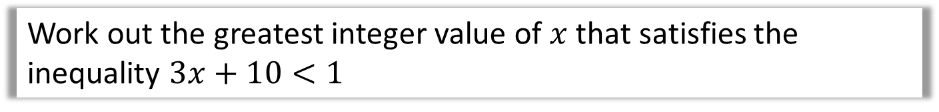
RECAP :: Linear Inequalities
Bromonology: Remember that ‘linear’ just means that if we plotted the equation/inequality we’d end up with a straight line/region bounded by a straight line.
Jan 2013 Paper 2
Solve $5d−3>d+17$
?
$$d>5$$
June 2012 Paper 1
Work out the greatest integer value of $x$ that satisfies the inequality $3x+10<1$
$$x<−3$$
Thus greatest integer is -4.
?
Solve $5<3x−1≤17$
?
$$6<3x≤18 \\ 2<x≤6$$

Slide 3
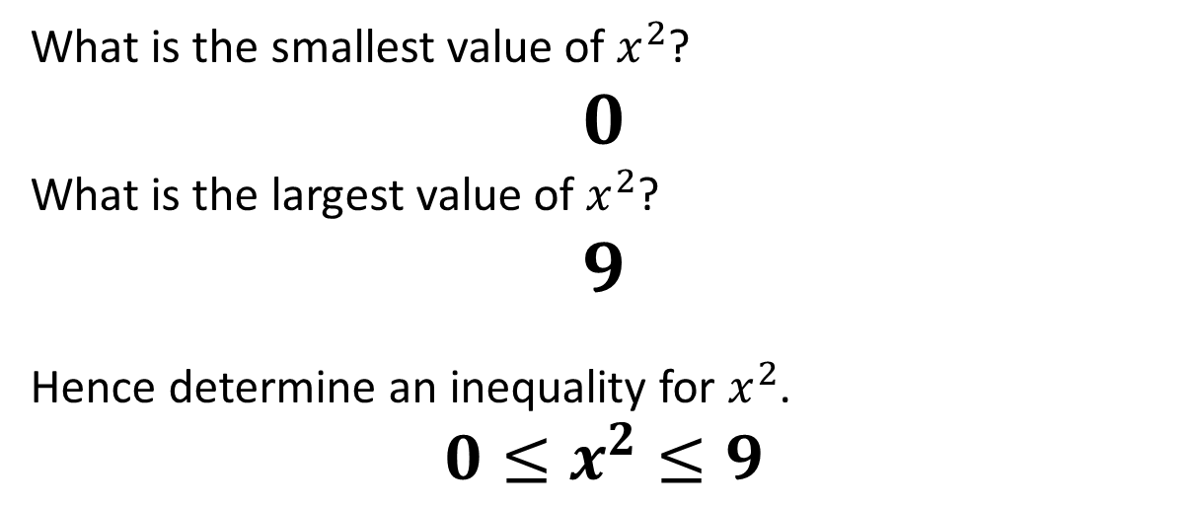

Manipulating Inequalities
$$−3≤x≤2$$
What is the smallest value of $x^{2}$?
$$0$$
What is the largest value of $x^{2}$?
$$9$$
Hence determine an inequality for $x^{2}$.
$$0≤x^{2}≤9$$
?
?
?

Slide 4
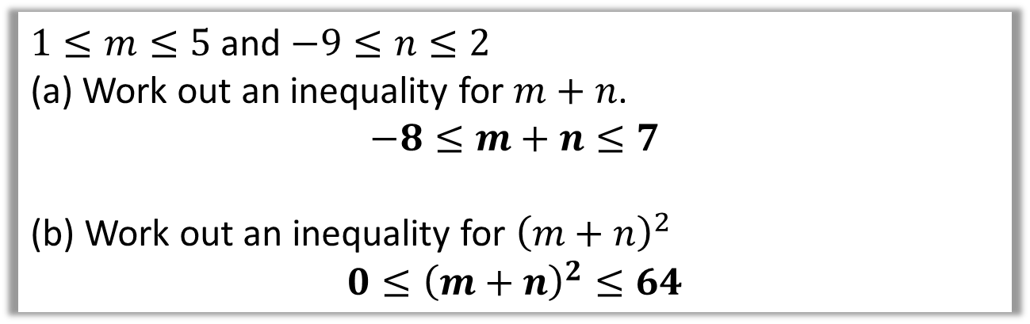
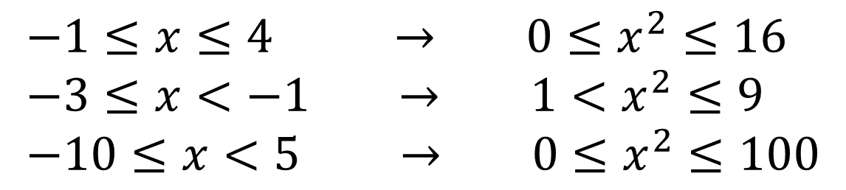
Test Your Understanding
?
?
$$−1≤x≤4 → 0≤x^{2}≤16 \\ −3≤x<−1 → 1<x^{2}≤9 \\ −10≤x<5 → 0≤x^{2}≤100$$
?
?
?
?
June 2012 Paper 1
$1≤m≤5$ and $−9≤n≤2$
(a) Work out an inequality for $m+n$.
$$−8≤m+n≤7$$
(b) Work out an inequality for ${\left(m+n\right)}^{2}$
$$0≤{\left(m+n\right)}^{2}≤64$$
?
?
?
?

Slide 5
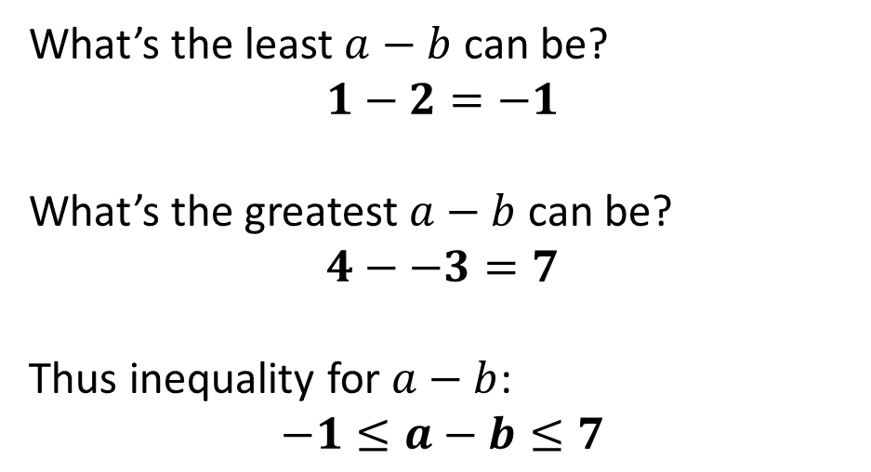
Further Example
Given that $1≤a≤4$ and $−3≤b≤2$, work out an inequality for $a−b$.
What’s the least $a−b$ can be?
$$1−2=−1$$
What’s the greatest $a−b$ can be?
$$4−−3=7$$
Thus inequality for $a−b$:
$$−1≤a−b≤7$$
?
?
?

Slide 6
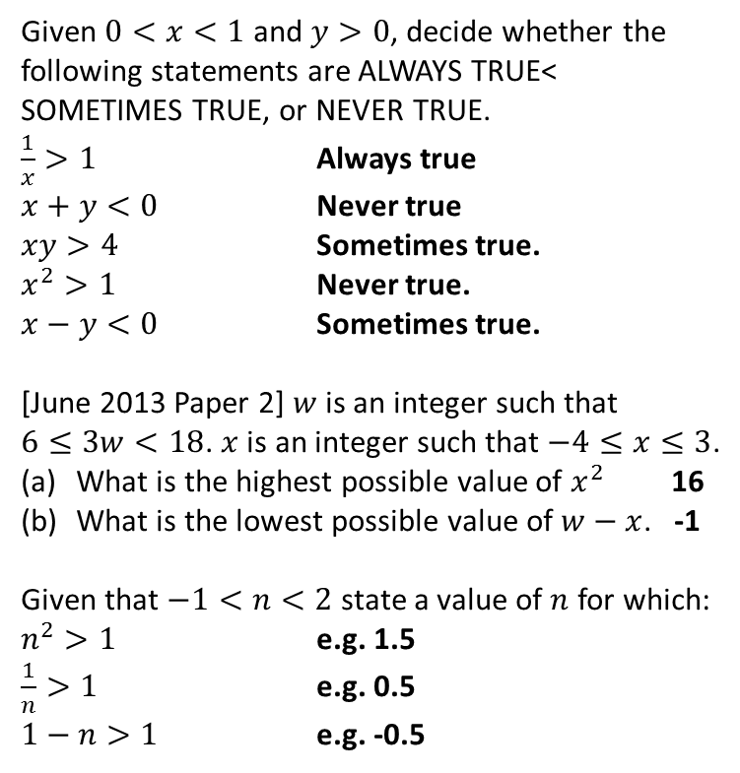
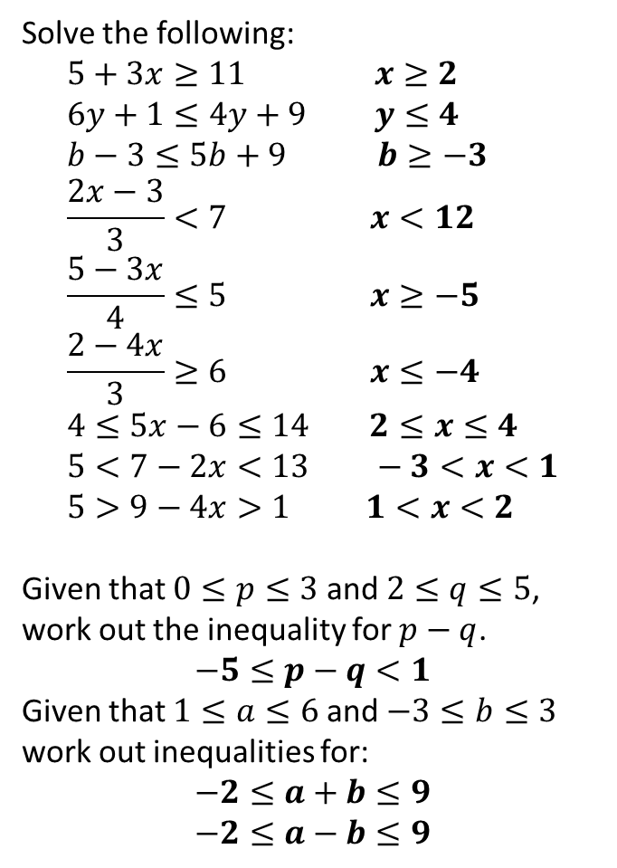
Exercise 1
1
Solve the following:
$$5+3x≥11 x≥2 \\ 6y+1≤4y+9 y≤4 \\ b−3≤5b+9 b≥−3 \\ \frac{2x−3}{3}<7 x<12 \\ \frac{5−3x}{4}≤5 x≥−5 \\ \frac{2−4x}{3}≥6 x≤−4 \\ 4≤5x−6≤14 2≤x≤4 \\ 5<7−2x<13 −3<x<1 \\ 5>9−4x>1 1<x<2$$
Given that $0≤p≤3$ and $2≤q≤5$, work out the inequality for $p−q$.
$$−5≤p−q<1$$
Given that $1≤a≤6$ and $−3≤b≤3$ work out inequalities for:
$$−2≤a+b≤9 \\ −2≤a−b≤9$$
Given $0<x<1$ and $y>0$, decide whether the following statements are ALWAYS TRUE< SOMETIMES TRUE, or NEVER TRUE.
$\frac{1}{x}>1$ Always true
$x+y<0$ Never true
$xy>4$ Sometimes true.
$x^{2}>1$ Never true.
$x−y<0$ Sometimes true.
[June 2013 Paper 2] $w$ is an integer such that $6≤3w<18$. $x$ is an integer such that $−4≤x≤3$.
What is the highest possible value of $x^{2}$ 16
What is the lowest possible value of $w−x$. -1
Given that $−1<n<2$ state a value of $n$ for which:
$n^{2}>1$ e.g. 1.5
$\frac{1}{n}>1$ e.g. 0.5
$1−n>1$ e.g. -0.5
4
a
?
b
?
c
?
a
?
?
b
?
d
c
?
e
?
d
?
e
?
f
?
5
g
?
?
h
?
?
i
?
6
2
a
?
b
?
?
c
?
3
?
?
?
?

Slide 7

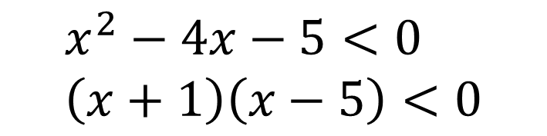
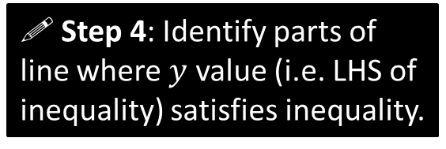




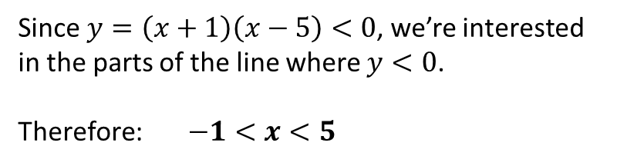
Quadratic Inequalities
Solve $x^{2}−4x−5<0$
$$x^{2}−4x−5<0 \\ \left(x+1\right)\left(x−5\right)<0$$
! Step 1: Get 0 on one side.
Step 2 ?
! Step 2: Factorise.
! Step 3: Sketch $y=LHS$.
$$y$$
Step 3 ?
$$y=\left(x+1\right)\left(x−5\right)$$
! Step 4: Identify parts of line where $y$ value (i.e. LHS of inequality) satisfies inequality.
$$x$$
-1
5
Step 4?
Since $y=\left(x+1\right)\left(x−5\right)<0$, we’re interested in the parts of the line where $y<0$.
Therefore: $−1<x<5$
?

Slide 8
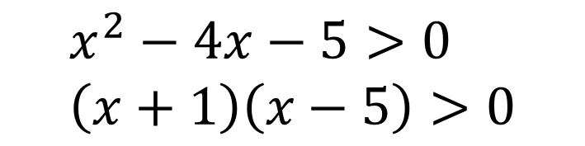

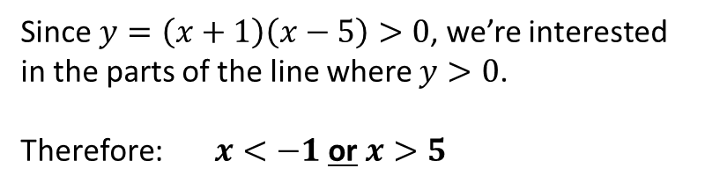
Quadratic Inequalities
Solve $x^{2}−4x−5>0$
Now suppose we changed < for >…
$$x^{2}−4x−5>0 \\ \left(x+1\right)\left(x−5\right)>0$$
! Step 1: Get 0 on one side.
! Step 2: Factorise.
! Step 3: Sketch $y=LHS$.
$$y$$
$$y=\left(x+1\right)\left(x−5\right)$$
! Step 4: Identify parts of line where $y$ value (i.e. LHS of inequality) satisfies inequality.
$$x$$
-1
5
Since $y=\left(x+1\right)\left(x−5\right)>0$, we’re interested in the parts of the line where $y>0$.
Therefore: $x<−1$or$x>5$
Step 4?

Slide 9
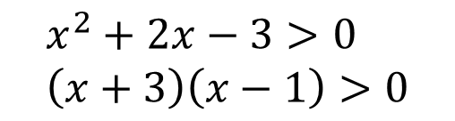

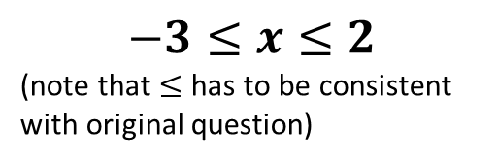
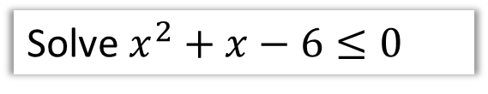

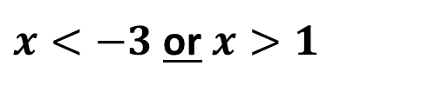




Test Your Understanding
Solve $x^{2}+x−6≤0$
Solve $2x+x^{2}>3$
?
?
$$\left(x+3\right)\left(x−2\right)≤0$$
$$x^{2}+2x−3>0 \\ \left(x+3\right)\left(x−1\right)>0$$
$$y$$
$$y$$
$$x$$
-3
2
$$x$$
-3
1
$$−3≤x≤2$$
(note that $≤$ has to be consistent with original question)
$x<−3$or$x>1$

Slide 10

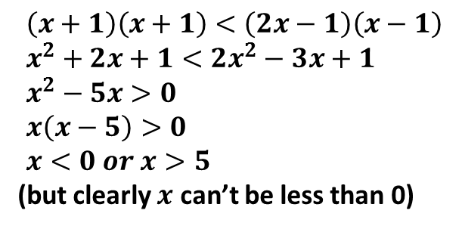
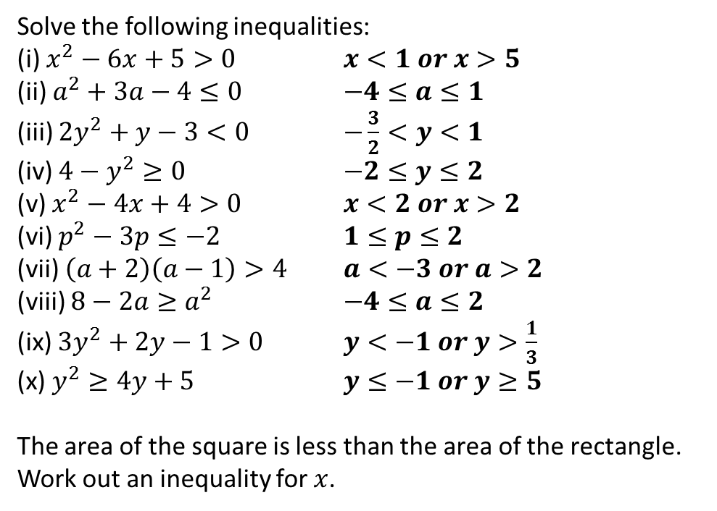



Exercise 2
1
Solve the following inequalities:
(i) $x^{2}−6x+5>0$ $x<1 or x>5$
(ii) $a^{2}+3a−4≤0$ $−4≤a≤1$
(iii) $2y^{2}+y−3<0$ $−\frac{3}{2}<y<1$
(iv) $4−y^{2}≥0$ $−2≤y≤2$
(v) $x^{2}−4x+4>0$ $x<2 or x>2$
(vi) $p^{2}−3p≤−2$ $1≤p≤2$
(vii) $\left(a+2\right)\left(a−1\right)>4$ $a<−3 or a>2$
(viii) $8−2a≥a^{2}$ $−4≤a≤2$
(ix) $3y^{2}+2y−1>0$ $y<−1 or y>\frac{1}{3}$
(x) $y^{2}≥4y+5$ $y≤−1 or y≥5$
The area of the square is less than the area of the rectangle. Work out an inequality for $x$.
?
?
?
?
?
?
?
?
?
?
2
$$x+1$$
$$2x−1$$
?
$$\left(x+1\right)\left(x+1\right)<\left(2x−1\right)\left(x−1\right) \\ x^{2}+2x+1<2x^{2}−3x+1 \\ x^{2}−5x>0 \\ x\left(x−5\right)>0 \\ x<0 or x>5$$
(but clearly $x$ can’t be less than 0)
$$x+1$$
$$x−1$$

Slide 11
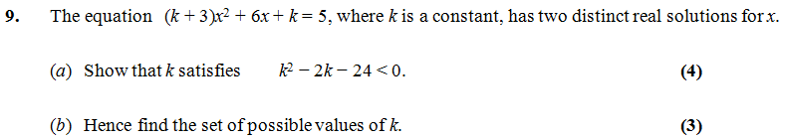

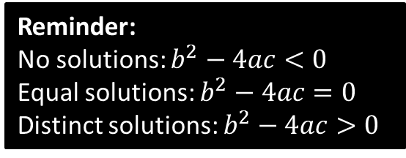
C1 Discriminants
We now (hopefully!) have the sufficient skills to tackle more questions concerning discriminants:
Edexcel C1 Jan 2013
a
?
$$\left(k+3\right)x^{2}+6x+\left(k−5\right)=0 \\ a=k+3 b=6 c=k−5$$ Discriminant: $36−4\left(k+3\right)\left(k−5\right)>0$
$$36−4\left(k^{2}−2k−15\right)>0 \\ 36−4k^{2}+8k+60>0 \\ 4k^{2}−8k−96<0 \\ k^{2}−2k−24<0$$
$$\left(k+4\right)\left(k−6\right)<0$$
After sketching: $−4<k<6$
?
Reminder:
No solutions: $b^{2}−4ac<0$
Equal solutions: $b^{2}−4ac=0$
Distinct solutions: $b^{2}−4ac>0$
?
?
b
?
?

Slide 12
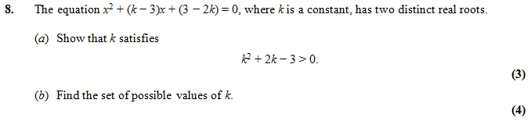
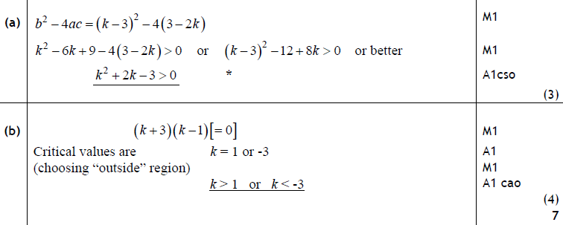
Test Your Understanding
Edexcel C1 Jan 2011
?
?

Slide 13
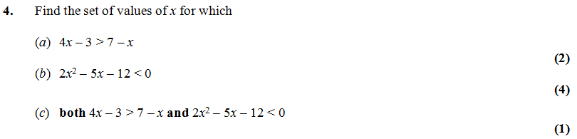
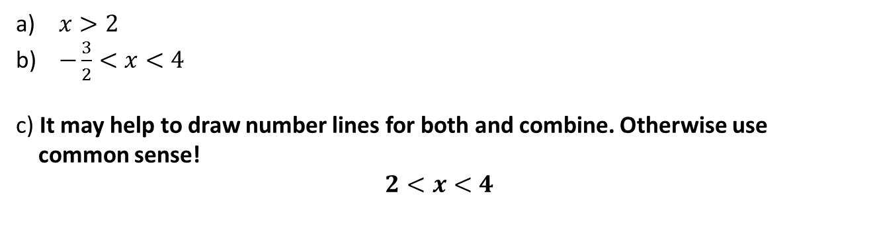
Combining Inequalities
Edexcel C1 June 2009
$x>2$
$−\frac{3}{2}<x<4$
c) It may help to draw number lines for both and combine. Otherwise use common sense! $$2<x<4$$
?

Slide 14
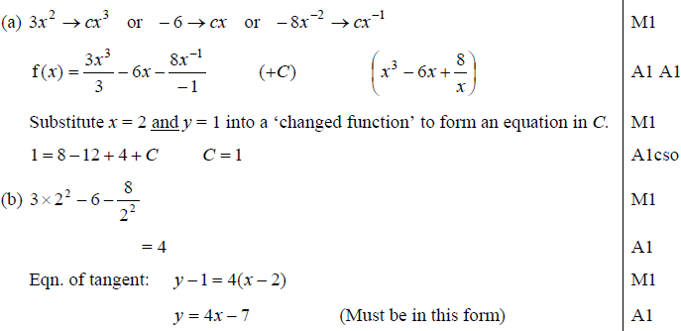
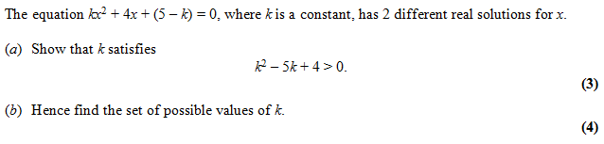
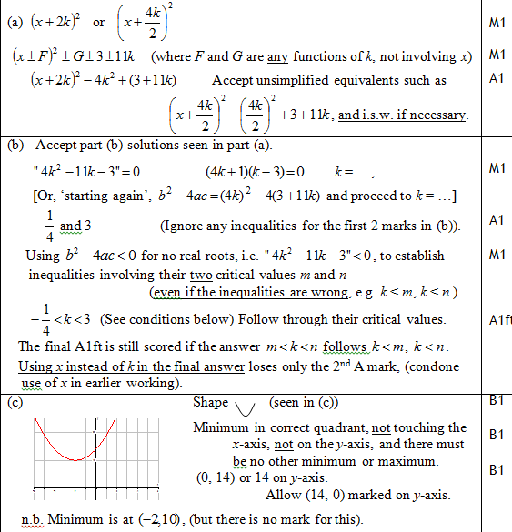
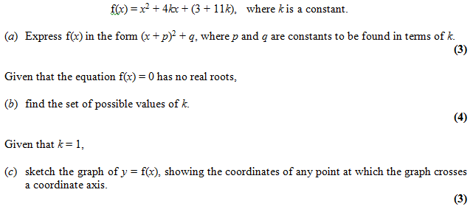
Exercise 3
Edexcel C1 Jan 2009 Q7
?
?
Edexcel C1 Jan 2010 Q10

