Slide 1

Year 8 Algebra Recap
Dr J Frost (jfrost@tiffin.kingston.sch.uk)
Objectives: (a) Recap simplifying expressions (b) Recap solving equations, including brackets and the variable appearing on both sides. (b) Form equations from context (with emphasis on quality of written communication, e.g. "Let x be...").
Last modified: 28th August 2015

Slide 2
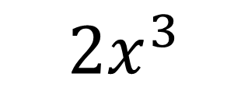
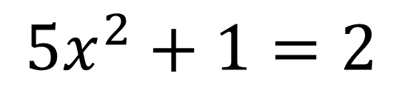
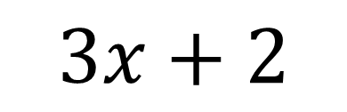
KEY TERMS
This is an example of a:
$$2x^{3}$$
Term
A term is a product of numbers and variables (no additions/subtractions)
?
$$3x+2$$
Expression
An expression is composed of one or more terms, whether added or otherwise.
?
?
$$5x^{2}+1=2$$
Equation
An equation says that the expressions on the left and right hand side of the = have the same value.

Slide 3
Quickfire Examples – Collecting ‘Like Terms’
?
$$x^{3}+x^{2}+x^{2}+x → x^{3}+2x^{2}+x$$
$$x^{2}y+3x^{3}−x^{2}y+xy^{2} → 3x^{3}+xy^{2}$$
$$3x^{2}+4x−x^{2}+x−3 → 2x^{2}+5x−3$$
$$3xy+3y+2+1 → 3xy+3y+3$$
$$8x^{2}−3x−x^{2}−4x → 7x^{2}−7x$$
?
?
?
?
Bro Recap: Terms are ‘like’ if they have the same variables and the same powers.

Slide 4
Multiplying
In algebra, we don’t like the $×$ symbol; instead we put things next to each other to indicate they are multiplied.
$$x×y → xy$$
$$y×x → xy$$
$$x×2 → 2x$$
$$x×x → x^{2}$$
$$x×xy → x^{2}y$$
$$y×xy → xy^{2}$$
$$2x×x → {2x}^{2}$$
$$2xy×3xy → 6x^{2}y^{2}$$
$$3xy×3yz → 9xy^{2}z$$
?
?
?
?
?
?
?
?
?

Slide 5
Division
$$\frac{6}{9} → \frac{2}{3}$$
?
Fractions are ultimately just divisions. How did we simplify this fraction?
Can we apply the same principle to algebraic division?
?
?
?
$$\frac{x^{2}y}{xy^{2}} → \frac{x}{y}$$
$$\frac{12xy^{2}z}{16xyz^{2}} → \frac{3y}{4z}$$
$$\frac{2x}{2} → x$$
$$\frac{5x}{x} → 5$$
$$\frac{2x^{2}}{3x} → \frac{2x}{3}$$
$$\frac{10xy}{15x} → \frac{2y}{3}$$
?
?
?

Slide 6
Test Your Understanding
$$\frac{6z}{3} → 2z$$
$$\frac{7x^{2}y^{2}}{xy} → 7xy$$
$$\frac{5a^{2}b^{2}c^{3}}{20ab^{2}c} → \frac{ac^{2}}{4}$$
$$x\left(\frac{9xy^{2}}{y}\right)−y\left(\frac{8x^{2}y^{2}}{{2y}^{2}}\right) → 5x^{2}y$$
?
?
?
?

Slide 7
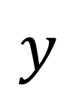
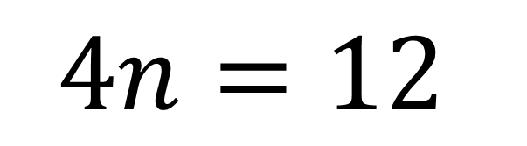
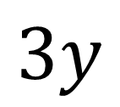
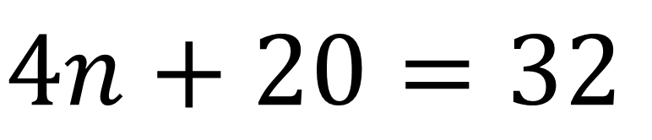
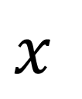
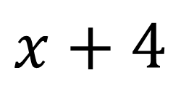
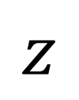
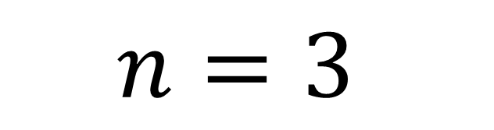
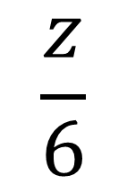
Solving
Bro Note: You can probably see the answer to this in your head because the equation is relatively simple, but this full method is crucial when things become more complicated
$$4n+20=32$$
Strategy: Do the opposite operation to ‘get rid of’ items surrounding our variable.
-20
?
-20
?
$$4n=12$$
?
?
-4
$$x+4$$
$$x$$
?
÷4
÷4
?
?
$$3y$$
÷3
$$y$$
$$n=3$$
?
$$\frac{z}{6}$$
?
×6
Bro Tip: Many students find writing these operations between each equation helpful to remind them what they’re doing to each side, but you’ll eventually want to wean yourself off these.
$$z$$

Slide 8
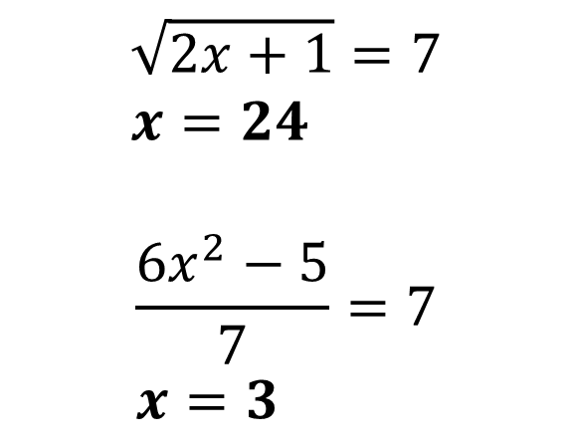
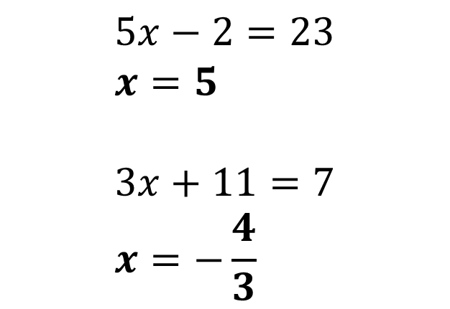
Test Your Understanding
Solve the following.
$$5x−2=23 \\ x=5$$
$$3x+11=7 \\ x=−\frac{4}{3}$$
$$\sqrt{2x+1}=7 \\ x=24$$
$$\frac{6x^{2}−5}{7}=7 \\ x=3$$
1
3
?
?
2
4
?
?

Slide 9
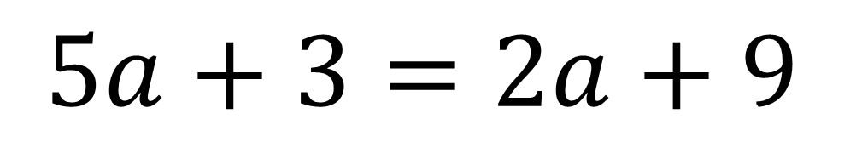
What happens if variable appears on both sides?
$$5a+3=2a+9$$
What might our strategy be?
?
Collect the variable terms (i.e. The terms involving a) on one side of the equation, and the ‘constants’ (i.e. The individual numbers) on the other side.

Slide 10
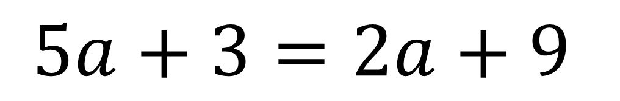

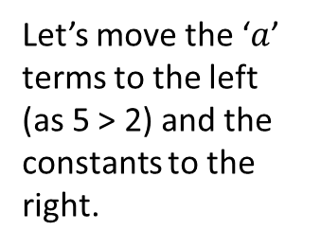
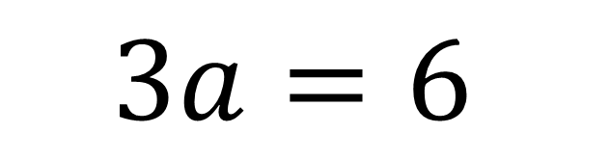
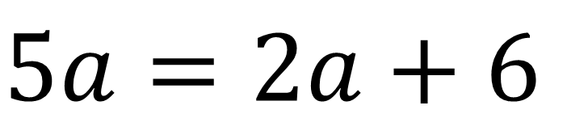
What happens if variable appears on both sides?
Strategy? Collect the variable terms on the side of the equation where there’s more of them (and move constant terms to other side).
?
Let’s move the ‘$a$’ terms to the left (as 5 > 2) and the constants to the right.
$$5a+3=2a+9$$
-3
-3
$$5a=2a+6$$
This is to get rid of the constant term on the left.
?
We could have done these two steps in either order.
?
-2a
-2a
?
$$3a=6$$
?
?
÷3
÷3
?
$$a=2$$
?

Slide 11


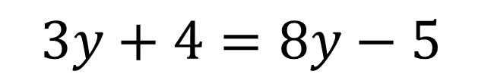
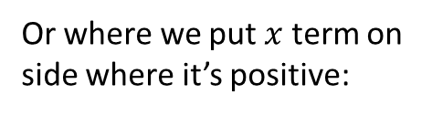


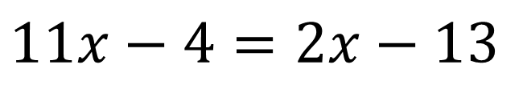

More Examples
$$11x−4=2x−13$$
$$3y+4=8y−5$$
$$x=−1$$
?
?
$$y=\frac{9}{5}$$
$$5=3−3x$$
Or where we put $x$ term on side where it’s positive:
Way we’d have previously done it…
Both methods are valid, but I prefer the second – it’s best to avoid dividing by negative numbers, and is less likely to lead to error.
$$5+3x=3 \\ 3x=−2 \\ x=−\frac{2}{3}$$
?
$$2=−3x \\ x=\frac{2}{−3}=−\frac{2}{3}$$
?

Slide 12


Test Your Understanding
$$3x−3=x+5 \\ 2x=8 \\ x=4$$
?
$$3−5x=5+2x \\ −2=7x \\ x=−\frac{2}{7}$$
?

Slide 13


Dealing with Brackets
If there’s any brackets, simply expand them first!
$$2\left(2x+3\right)=9 \\ 4x+6=9 \\ 4x=−3 \\ x=−\frac{3}{4}$$
$$3−4\left(2x−3\right)=7x \\ 3−8x+12=7x \\ 15−8x=7x \\ 15=15x \\ x=1$$
?
?

Slide 14


Test Your Understanding
$$7\left(3x−1\right)=21+14x \\ 21x−7=21+14x \\ 7x=28 \\ x=4$$
$$5−2\left(x+2\right)=4−3\left(2−x\right) \\ 5−2x−4=4−6+3x \\ 1−2x=−2+3x \\ 3=5x \\ x=\frac{3}{5}$$
?
?

Slide 15
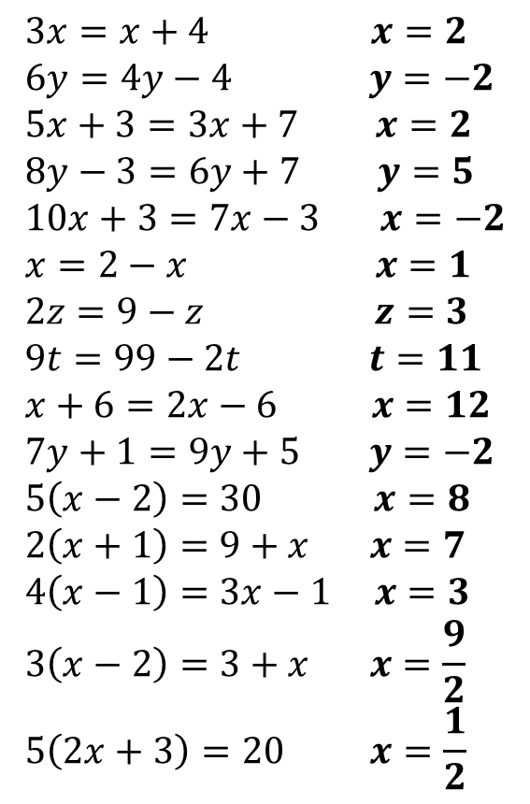
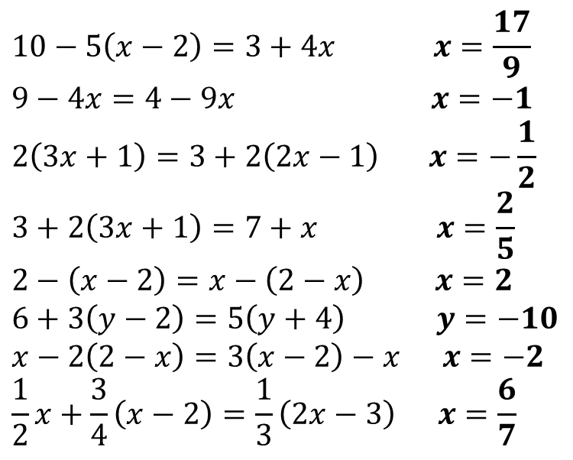
Exercise 1
Solve the following.
$$10−5\left(x−2\right)=3+4x x=\frac{17}{9} \\ 9−4x=4−9x x=−1 \\ 2\left(3x+1\right)=3+2\left(2x−1\right) x=−\frac{1}{2} \\ 3+2\left(3x+1\right)=7+x x=\frac{2}{5}$$
$$2−\left(x−2\right)=x−\left(2−x\right) x=2$$
$$6+3\left(y−2\right)=5\left(y+4\right) y=−10 \\ x−2\left(2−x\right)=3\left(x−2\right)−x x=−2 \\ \frac{1}{2}x+\frac{3}{4}\left(x−2\right)=\frac{1}{3}\left(2x−3\right) x=\frac{6}{7}$$
$$3x=x+4 x=2 \\ 6y=4y−4 y=−2 \\ 5x+3=3x+7 x=2 \\ 8y−3=6y+7 y=5 \\ 10x+3=7x−3 x=−2 \\ x=2−x x=1 \\ 2z=9−z z=3 \\ 9t=99−2t t=11 \\ x+6=2x−6 x=12 \\ 7y+1=9y+5 y=−2 \\ 5\left(x−2\right)=30 x=8 \\ 2\left(x+1\right)=9+x x=7 \\ 4\left(x−1\right)=3x−1 x=3 \\ 3\left(x−2\right)=3+x x=\frac{9}{2} \\ 5\left(2x+3\right)=20 x=\frac{1}{2}$$
?
1
?
16
2
?
3
?
17
?
4
?
?
18
5
?
?
?
6
19
7
?
?
20
?
8
21
?
9
?
?
22
?
10
?
?
11
N
12
?
13
?
?
14
?
15

Slide 16
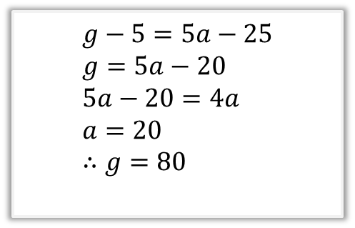
RECAP :: Forming/Solving Process
Worded problem
[JMC 2008 Q18] Granny swears that she is getting younger. She has calculated that she is four times as old as I am now, but remember that 5 years ago she was five times as old as I was at that time. What is the sum of our ages now?
Stage 1: Represent problem algebraically
Stage 2: ‘Solve’ equation(s) to find value of variables.
Let $a$ be my age and $g$ be Granny’s age.
$$g=4a \\ g−5=5(a−5)$$
$$g−5=5a−25 \\ g=5a−20 \\ 5a−20=4a \\ a=20 \\ ∴g=80$$

Slide 17
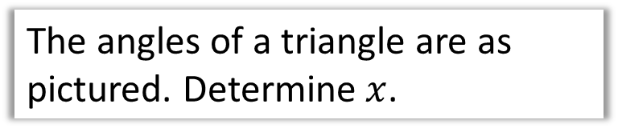




Example
The angles of a triangle are as pictured. Determine $x$.
$$x+10$$
Step 1: Find two different expressions for the thing of interest (one of them often a provided number)
Step 2: Set them equal to each other.
$$2x$$
$$x−50$$
Step 3: Solve!
Expr 1?
Expr 2?
$$x+10+2x+x−50=180 \\ 4x−40=180 \\ 4x=220 \\ x=55$$
Solve!

Slide 18





Another Example
$$x+4$$
$$3$$
$$x$$
$$10$$
The rectangle and triangle have the same area. Determine the width of the rectangle.
Expr 1?
Expr 2?
$$3\left(x+4\right)=5x \\ 3x+12=5x \\ 12=2x \\ x=6$$
Therefore width of rectangle is $6+4=10$
Step 1: Find two different expressions for the thing of interest (one of them often a provided number)
Solve!
Step 2: Set them equal to each other.
Step 3: Solve!

Slide 19
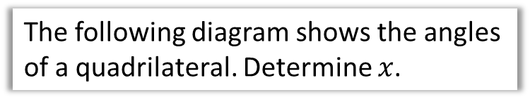

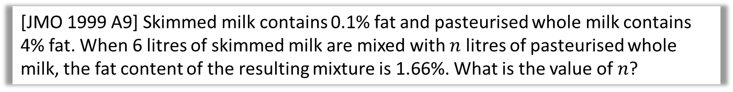


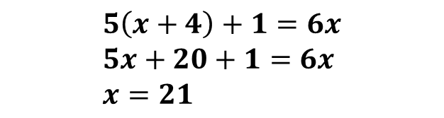


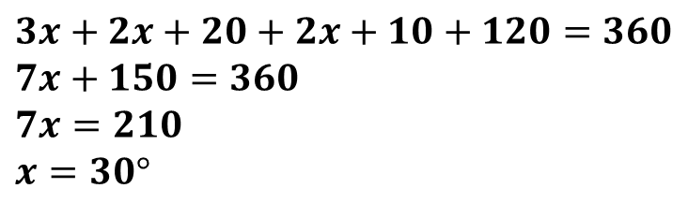
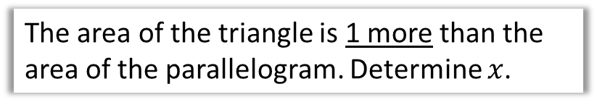



Check Your Understanding
1
The following diagram shows the angles of a quadrilateral. Determine $x$.
$$3x$$
$$2x+10$$
Expr 1?
Expr 2?
$$3x+2x+20+2x+10+120=360 \\ 7x+150=360 \\ 7x=210 \\ x=30°$$
$$120$$
Solve!
$$2x+20$$
2
The area of the triangle is 1 more than the area of the parallelogram. Determine $x$.
$$x+4$$
$$x$$
Expr 1?
Expr 2?
$$5\left(x+4\right)+1=6x \\ 5x+20+1=6x \\ x=21$$
$$5$$
$$12$$
Solve!
N
[JMO 1999 A9] Skimmed milk contains 0.1% fat and pasteurised whole milk contains 4% fat. When 6 litres of skimmed milk are mixed with $n$ litres of pasteurised whole milk, the fat content of the resulting mixture is 1.66%. What is the value of $n$?
$$6×0.001+0.04n=0.0166\left(n+6\right) → n=4$$
?

Slide 20
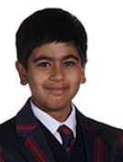
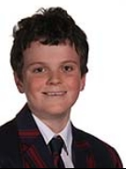
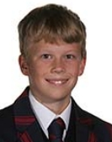

Forming the expressions yourself
Thomas is 5m shorter than Sebastian. Raul is double the height of Sebastian. Their combined height is 35m. Find Sebastian’s height.
?
Let Sebastian’s height be $x$.
Then Thomas’ height is $x−5$.
Raul’s height is $2x$.
Then: $x+x−5+2x=35$
$$4x−5=35 \\ x=10$$
$∴$ Sebastian’s height is 10m.
Use the word “Let …” to define your variable(s)!
?
You want a clear narrative while been as concise as possible.
?

Slide 21
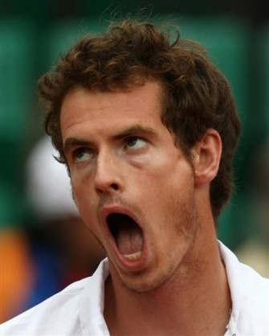
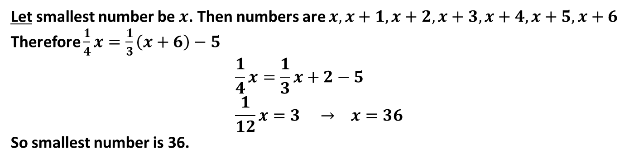
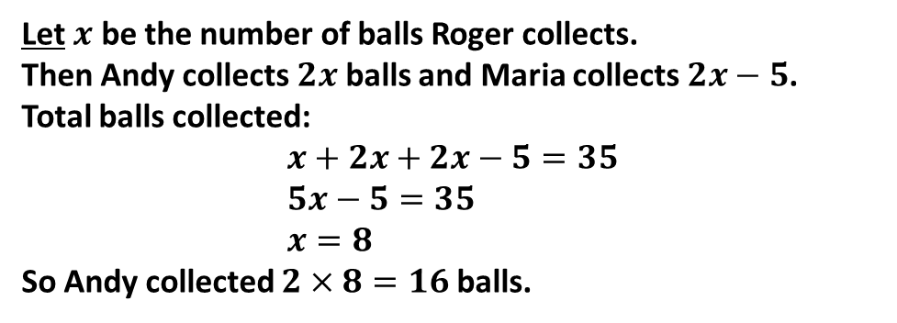
More Examples
[JMC 2013 Q7] After tennis training, Andy collects twice as many balls as Roger and five more than Maria. They collect 35 balls in total. How many balls does Andy collect?
Let $x$ be the number of balls Roger collects.
Then Andy collects $2x$ balls and Maria collects $2x−5$.
Total balls collected:
$$x+2x+2x−5=35 \\ 5x−5=35 \\ x=8$$
So Andy collected $2×8=16$ balls.
?
[TMC Regional 2014 Q9] In a list of seven consecutive numbers a quarter of the smallest number is five less than a third of the largest number. What is the value of the smallest number in the list?
Let smallest number be $x$. Then numbers are $x, x+1, x+2, x+3, x+4, x+5, x+6$
Therefore $\frac{1}{4}x=\frac{1}{3}\left(x+6\right)−5$
$$\frac{1}{4}x=\frac{1}{3}x+2−5 \\ \frac{1}{12}x=3 → x=36$$
So smallest number is 36.
?

Slide 22
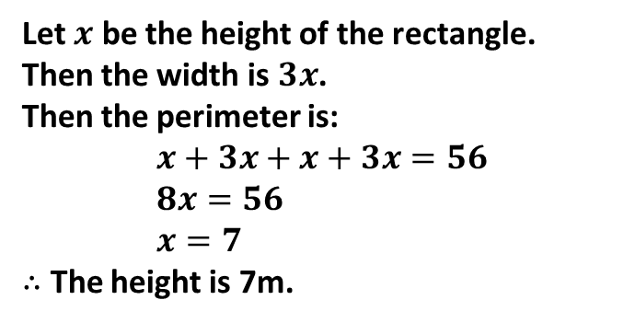

Test Your Understanding
1
The width of the rectangle is three times the height. The total perimeter is 56m. Determine its height.
Let $x$ be the height of the rectangle.
Then the width is $3x$.
Then the perimeter is:
$$x+3x+x+3x=56 \\ 8x=56 \\ x=7$$
$∴$ The height is 7m.
?
Bro Reminder: You should usually start with “Let …”
2
In 4 years time I will be 3 times as old as I was 10 years ago. How old am I?
Let $a$ be my age.
Then $a+4=3\left(a−10\right)$
$$a+4=3a−30 \\ 2a=34 \\ a=17$$
?

Slide 23







Exercise 2
(Teacher Note: For printout see “Year 7 – Equations Ex3” - http://www.drfrostmaths.com/resource.php?id=11640 )
1
Three angles in a triangle are $x, 2x+20°$ and $7x−10°$. What is $x$? $x=17°$
Two angles on a straight line are $x+30°$ and $2x−60°$. What is $x$? $x=70°$
The area of this rectangle is 48. Determine $x$.
$x=7$
An equilateral triangle has lengths $3x+6, 5x, 5x$. What is $x$? $x=3$
[JMC 1998 Q18] The three angles of a triangle are $\left(x+10\right)°$, $\left(2x−40\right)°$, $\left(3x−90\right)°$. Which statement about the triangles is correct? It is: A right-angled isosceles B right-angled, but not isosceles C equilateral D obtuse-angled and isosceles E none of A-D
Solution: C
6
The sum of 5 consecutive numbers is 200. What is the smallest number?
Solution: 38 (a quick non-algebraic method is to realise the middle number is the average of the 5, i.e. 40)
[JMO 2013 A7] Calculate the value of $x$ in the diagram shown?
Solution: 36
The perimeter of this rectangle is 44. What is $x$? Solution: 7
?
?
2
?
$$x+5$$
3
7
$$4$$
4
?
5
?
8
?
$$2x+3$$
$$x−2$$
?

Slide 24


Exercise 2
9
In 5 years time I will be 5 times as old as I was 11 years ago. Form a suitable equation, and hence determine my age.
$$a+5=5\left(a−11\right) \\ a=15$$
In 6 years time I will be twice as old as I was 8 years ago. Determine my age.
$$a+6=2\left(a−8\right) \\ a=22$$
I have three times as many cats as Alice but Bob has 7 less cats than me. In total we have 56 cats. How many cats do I have? 27
12
[TMC Final 2012 Q1] A Triple Jump consists of a hop, step and jump. The length of Keith’s step was three-quarters of the length of his hop and the length of his jump was half the length of his step. If the total length of Keith’s triple jump was 17m, what was the length of his hop, in metres? Solution: 8 metres
[JMO 2003 A6] Given a “starting” number, you double it and add 1, then divide the answer by 1 less than the starting number to get the “final” number. If you start with 2, your final number is 5. If you start with 4, your final number is 3. What starting number gives the final number 4? Solution: $\frac{2x+1}{x−1}=4$
$$2x+1=4\left(x−1\right) \\ x=\frac{5}{2}$$
?
10
?
?
13
11
?
?

Slide 25





Exercise 2
14
[JMO 2012 A3] In triangle $ABC$, $∠CAB=84°$; $D$ is a point on $AB$ such that $∠CDB=3×∠ACD$ and $DC=DB$. What is the size of $∠BCD$?
Solution: Let $∠ACD=x$, then $∠CDB=3x$ and $∠ADC=180−3x$. Angles in $ΔACD$:
$$84+\left(180−3x\right)+x=180 \\ x=42°$$
Then $∠DCB=\frac{180−126}{2}=27°$
[JMO 2005 A8] A large container holds 14 litres of a solution which is 25% antifreeze, the remainder being water. How many litres of antifreeze must be added to the container to make a solution which is 30% antifreeze?
Let $x$ be the amount of antifreeze added in litres. 25% of 14 is 3.5. Thus: $$3.5+x=0.3\left(14+x\right) \\ x=1$$
16
[JMC 2012 Q24] After playing 500 games, my success rate in Spider Solitaire is 49%. Assuming I win every game from now on, how many extra games do I need to play in order that my success rate increases to 50%? A 1 B 2 C 5 D 10 E 50
Let $x$ be the number of extra games played. Then, giving 245 games were won before:
$$245+x=0.5\left(500+x\right) \\ x=10$$
(Note: it’s easier to just exploit the fact it’s multiple choice and try the options!)
[JMO 2008 A9] In the diagram, $CD$ is the bisector of angle $ACB$. Also $BC=CD$ and $AB=AC$. What is the size of angle $CDA$?
?
?
15
17
Let $∠DCB=x$. Filling in the angles using the information we find angles in $ΔDAC$ are $x, 180−2x$ and $180−4x$. This gives $x=36°$ .
$$∴∠CDA=180−\left(2×36\right)=108°$$
?
?
(Note: this is not intended to be a full proof!)

Slide 26












Exercise 2
18
[JMO 2010 A10] Inn the diagram, $JK$ and $ML$ are parallel. $JK=KO=OJ=OM$ and $LM=LO=LK$. Find the size of angle $JMO$.
19
[JMO 2013 B2] Pippa thinks of a number. She adds 1 to it to get a second number. She then adds 2 to the second number to get a third number, adds 3 to the third to get a fourth, and finally adds 4 to the fourth to get a fifth number. Pippa’s brother Ben also thinks of a number but he subtracts 1 to get a second. He then subtracts 2 from the second to get a third, and so on until he has five numbers. They discover that the sum of Pippa’s five numbers is the same as the sum of Ben’s five numbers. What is the difference between the two numbers of which they first thought?
Let $x$ be Pippa’s first number. Then her numbers are $x, x+1, x+3, x+6, x+10$. Sum is $5x+20$.
Let $y$ be Ben’s first number. Then his numbers are $y, y−1, y−3, y−6, y−10$. Sum is $5y−20$
We’re told $5x+20=5y−20$ and the difference between their two starting numbers is $y−x$. Rearranging:
$$5x+20=5y−20 \\ 5y−5x=40 \\ ∴y−x=8$$
$$60°$$
$$x$$
$$x−60°$$
$$60°$$
$$300−2x$$
$$x$$
$$x$$
$$x−60°$$
$$x$$
Since $JK$ and $ML$ are parallel, $∠KJM$ and $∠JML$ are cointerior so add to $180°$.
If we let $∠KOL=x$, we can eventually find the angles as pictured.
$$\left(x−60\right)+60+\left(x−60\right)+x=180 \\ x=80° ∴∠JMO=80−60=20°$$
?
?

Slide 27



Exercise 2
20
[JMO 2005 B4] In this figure $ADC$ is a straight line and $AB=BC=CD$. Also, $DA=DB$. Find the size of $∠BAC$. (Full proof needed)
Full proof:
Let $∠DAB=x$
Then $∠DBA=x$ (base angles of isosceles $ΔDAB$ are equal)
$∠ACB=x$ (base angles of isosceles $ΔABC$ are equal)
$∠CDB=2x$ (exterior angle of triangle $ΔDAB$ is sum of two interior angles)
$∠DBC=2x$ (base angles of isosceles $ΔBCD$ are equal)
The angles in a triangle sum to $180°$. Using the angles in $ΔABC$:
$$x+x+2x+x=180° \\ 5x=180° \\ x=36°$$
(We could have also used the angles in $ΔBCD$)
?

