Slide 1
GCSE: Vectors
Dr J Frost (jfrost@tiffin.kingston.sch.uk)
www.drfrostmaths.com
Last modified: 31st August 2015

Slide 2
Starter
b
( )
1
3
( )
?
5
1
?
a =
b =
a
d
( )
2
-3
( )
?
-4
2
?
c =
d =
f
e
( )
( )
-1
1
-4
-4
?
?
f =
c
e =
Bro Tip: Ensure you can distinguish between coordinates and vectors.
$(x,y)$ Coordinates represent positions.
$\left({x \atop y}\right)$ Vectors represent movement.

Slide 3
What is a vector?
A vector is an entity with 2 properties:
Direction
Magnitude (the length)
?
?
Vectors are equal if:
Same direction & magnitude
?

Slide 4
Writing Vectors
Just like conventional algebra, we can represent vectors as variables.
There’s 3 ways in which can represent the vector from point X to Z:
$a$ (in bold)
$\underline{a}$ (with an ‘underbar’)
$\vec{XZ}$
Y
b
Z
a
X

Slide 5
Adding/Subtracting/Scaling Vectors
XY =
Determine:
a
+ b
?
XZ = 2a
?
XR = 2a + 2b
Click to Start Bromanimation
a
T
a
R
XQ = 2a + b
?
b
b
b
M
3
2
XM = a + b
?
a
Y
a
Q
YZ = a – b
?
b
b
b
RS = -2b – a
?
a
a
X
S
Z
1
2
?
MQ = - b + a
(M is the midpoint of the line YT)

Slide 6
Combining Portions of Vectors
$$C$$
$$P$$
$$b$$
$$A$$
$$a$$
$$Y$$
$$X$$
$$B$$
Let $\vec{AB}=a$ and $\vec{BC}=b$
Let $X$ be the midpoint of $AB$, $Y$ be a point on $BC$ such that $BY:YC=1:3$ and $P$ be a point on $AC$ such that $AP:PC=2:1$
Find:
?
$$\vec{AX}=\frac{1}{2}a \\ \vec{AY}=a+\frac{1}{4}b \\ \vec{CY}=−\frac{3}{4}b$$
?
$$\vec{AC}=a+b \\ \vec{AP}=\frac{2}{3}\vec{AC}=\frac{2}{3}a+\frac{2}{3}b$$
?
?
?

Slide 7
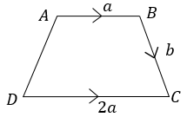
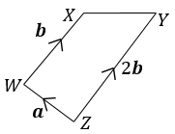
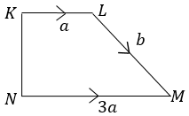
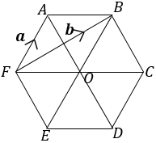
Exercise 1 (on your sheet)
1
3
?
$\vec{BA}=−a$
$\vec{AC}=a+b$
$\vec{DB} =2a−b$
$\vec{AD}=−a+b$
?
$\vec{ZX}=a+b$
$\vec{YW}=a−2b$
$\vec{XY} −a+b$
$\vec{XZ}=−a−b$
?
?
?
?
?
?
2
4
?
$\vec{MK} =−a−b$
$\vec{NL}=3a−b$
$\vec{NK} =2a−b$
$\vec{KN}=−2a+b$
?
?
$\vec{AB}=−a+b$
$\vec{FO}=−a+b$
$\vec{AO}=−2a+b$
$\vec{FD}=−3a+2b$
?
?
?
?
?

Slide 8
Quick fire ratio
A
P
B
z
The vector $z=\vec{AB}$
Find the following vectors given the specified ratios:
$$\vec{AP}$$
$$\vec{BP}$$
$$\frac{1}{2}z$$
$$−\frac{1}{2}z$$
?
?
$$AP:PB = 1:1$$
$$\frac{1}{3}z$$
?
?
$$−\frac{2}{3}z$$
$$AP:PB =1:2$$
?
?
$$\frac{3}{7}z$$
$$−\frac{4}{3}z$$
$$AP:PB =3:4$$

Slide 9
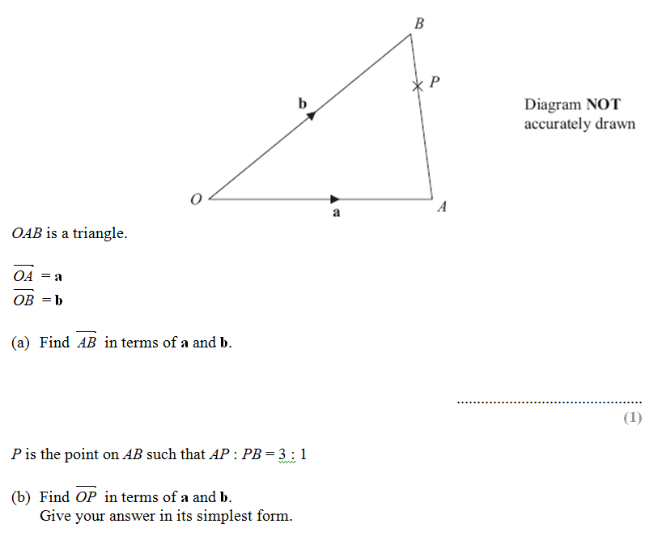
More Complex Paths
Bro Tip: GCSE vectors questions will almost always be in two parts: Part (b) will use your answer from part (a).
$$\vec{AB}=\vec{AO}+\vec{OB}$$
$=−a+b$
?
$$\vec{OP}=a+\frac{3}{4}\vec{AB}$$
$=a+\frac{3}{4}\left(−a+b\right)$
$=\frac{1}{4}a+\frac{3}{4}b$
?
You MUST expand and simplify.

Slide 10
Test Your Understanding
1
$$OX:XB=1:3$$
$$B$$
2
$$AY:YB=2:3$$
$$B$$
$$b$$
$$X$$
$$b$$
$$Y$$
$$O$$
$$a$$
$$A$$
$$O$$
$$a$$
$$A$$
$$\vec{AX}=−a+\frac{1}{4}\vec{OB} \\ =−a+\frac{1}{4}\left(a+b\right) \\ =−a+\frac{1}{4}a+\frac{1}{4}b \\ =−\frac{3}{4}a+\frac{1}{4}b$$
First Step?
First Step?
$$\vec{OY}=a+\frac{2}{5}\vec{AB} \\ =a+\frac{2}{5}\left(−a+b\right) \\ =a−\frac{2}{5}a+\frac{2}{5}b \\ =\frac{3}{5}a+\frac{2}{5}b$$
?
?

Slide 11
TEST YOUR UNDERSTANDING
Vote with your diaries!
(use the front for blue)
A
B
C
D

Slide 12
Given that M is the midpoint of BC, determine AM.
B
6a
M
A
4b
C
3a + 2b
3a + b
2a + 3b
a + b

Slide 13
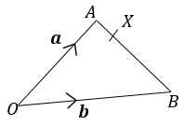
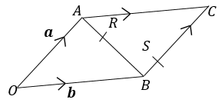
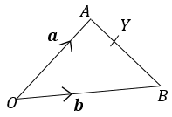
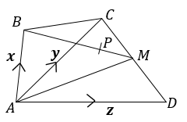
Exercise 2 (on your sheet)
1
3
?
$\vec{OR}=a+\frac{2}{5}\left(−a+b\right)$ $=\frac{3}{5}a+\frac{2}{5}b$
$\vec{BS}=\frac{1}{4}a$
$\vec{OS}=\frac{1}{4}a+b$
$\vec{RS}=\frac{3}{5}\left(−a+b\right)+\frac{1}{4}a$ $=−\frac{7}{20}a+\frac{3}{5}b$
$\vec{AB}=−a+b$
$\vec{AX}=−\frac{1}{5}a+\frac{1}{5}b$
$\vec{OX}=\frac{4}{5}a+\frac{1}{5}b$
$\vec{BX}=\frac{4}{5}a−\frac{4}{5}b$
?
?
?
?
?
?
?
2
4
$\vec{AY}=−\frac{1}{3}a+\frac{1}{3}b$
$\vec{OY}=\frac{2}{3}a+\frac{1}{3}b$
$\vec{YO}=−\frac{2}{3}a−\frac{1}{3}b$
?
?
?
$\vec{DC}=−z+y$
$\vec{DM}=−\frac{1}{2}z+\frac{1}{2}y$
$\vec{AM}=\vec{AD}+\vec{DM}=\frac{1}{2}z+\frac{1}{2}y$
$\vec{BM}=\vec{BA}+\vec{AM}=−x+\frac{1}{2}z+\frac{1}{2}y$
$\vec{BP}=\frac{2}{3}\vec{BM}=−\frac{2}{3}x+\frac{1}{3}z+\frac{1}{3}y$
$\vec{AP}=\vec{AB}+\vec{BP}=\frac{1}{3}x+\frac{1}{3}z+\frac{1}{3}y$
?
?
?
?
?
?

Slide 14
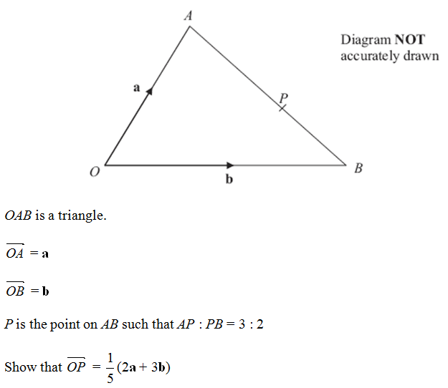
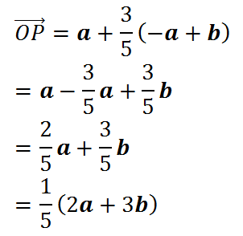
Recap
?

Slide 15
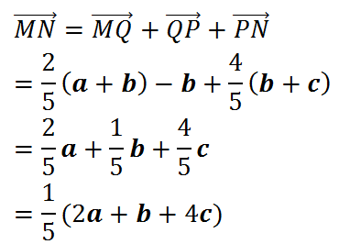
Dealing with more complicated ‘routes’
The ratio of the lengths $OM$ to $MQ$ is 3:2.
The ratio of the lengths $PN$ to $NR$ is 4:1.
Find $\vec{MN}$
P
a
N
R
O
b
c
?
M
Q
The key is to choose a suitable ‘route’ and work out each part separately before adding. Sometimes there are multiple possible routes.
But try to use vectors you have found in previous parts of the question.

Slide 16
Test Your Understanding
$$A$$
$$C$$
$$a$$
$$M$$
$$X$$
$$O$$
$$b$$
$$B$$
Given that $X$ is a point such that $AX:XB=3:1$ and $M$ is the midpoint of $BC$, find:
?
$$\vec{AB}=−a+b$$
$$\vec{XM}=\frac{1}{4}\left(−a+b\right)+\frac{1}{2}a \\ =\frac{1}{4}a+\frac{1}{4}b$$
?

Slide 17
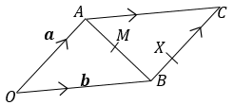
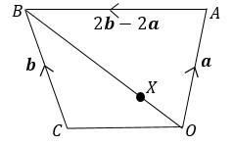
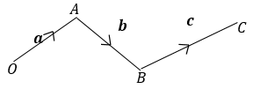
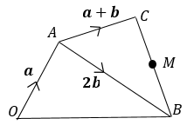
Exercise 3 (on sheet)
?
1
$\vec{OB}=a+2b$
$\vec{BC}=a−b$
$\vec{AM}=\frac{1}{2}a+b$
$\vec{OM}=\frac{3}{2}a+b$
4
?
?
?
$\vec{AB}=−a+b$
$\vec{BC}=a$
$\vec{MB}=−\frac{1}{2}a+\frac{1}{2}b$
$\vec{MX}=−\frac{1}{6}a+\frac{1}{2}b$
$\vec{XA}=\frac{2}{3}a−b$
$\vec{CM}=−\frac{1}{2}a−\frac{1}{2}b$
$\vec{XO}=−\frac{1}{3}a−b$
?
?
?
$\vec{OC}=−a+b$
$\vec{XC}=−\frac{3}{4}a+\frac{1}{2}b$
$\vec{AX}=−\frac{5}{4}a+\frac{1}{2}b$
?
3
?
?
?
?
?
?
$\vec{XY}=\frac{1}{2}a+\frac{1}{3}b$
$\vec{YZ}=\frac{2}{3}a+\frac{1}{4}c$
$\vec{XZ}=\frac{1}{2}a+b+\frac{1}{4}c$
$\vec{OZ}=a+b+\frac{1}{4}c$
$\vec{CX}=−c−b−\frac{1}{2}a$
?
?
?
2
?
?

Slide 18
What do you notice?
$$a$$
$$2a$$
$$a+2b$$
$$2a+4b$$
! Vectors are parallel if they have the same direction (but possibly different magnitudes).
?
$$a$$
$$−\frac{3}{2}a$$

Slide 19
Parallel or not parallel?
Vector 1 | Vector 2 | Parallel? (in general)
$$a+b$$ | $$a+2b$$
$$a+b$$ | $$3a+3b$$
$$a+2b$$ | $$−3a−6b$$
$$a−b$$ | $$−a+b$$
✓
No
✗
Yes
✗
No
✓
Yes
✗
No
✓
Yes
✗
No
✓
Yes
For ones which are parallel, show it diagrammatically.

Slide 20
How to show two vectors are parallel
$$A$$
$$C$$
$$a$$
$$M$$
$$X$$
$$O$$
$$b$$
$$B$$
We earlier found that $\vec{XM}=\frac{1}{4}a+\frac{1}{4}b$
How do we show this is parallel to $\vec{OC}?$
?
! To show parallel, factor out scalars so same vector in brackets:
$$\vec{XM}=\frac{1}{4}\left(a+b\right)$$ Then write “$\vec{XM}$ is a multiple of $\vec{OC}$”

Slide 21
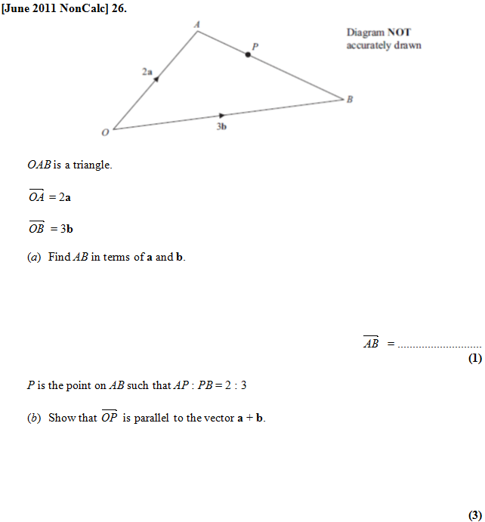
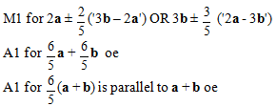
Test Your Understanding
?
?

Slide 22
Proving three points form a straight line
Points A, B and C form a straight line if:
$\vec{AB}$ and $\vec{BC}$ are parallel (and B is a common point).
Alternatively, we could show $\vec{AB}$ and $\vec{AC}$ are parallel.
?
C
B
A
C
B
A

Slide 23
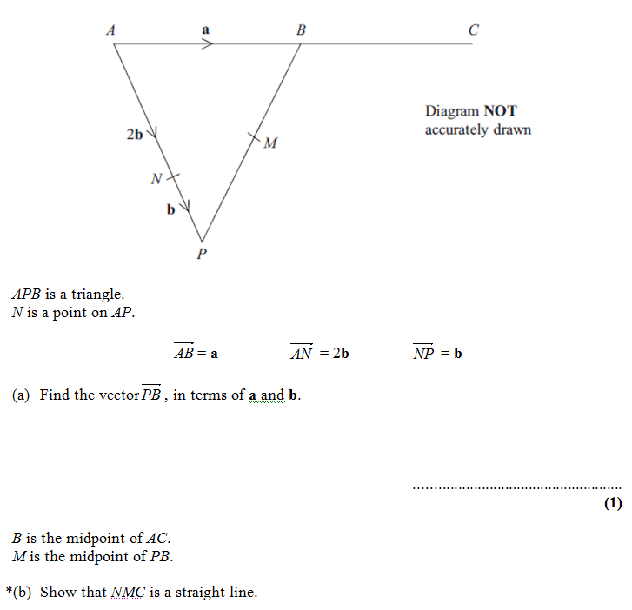
Test Your Understanding
$$\vec{NM}=b+\frac{1}{2}\left(a−3b\right) \\ \vec{MC}=\frac{1}{2}\left(a−3b\right)+a$$ Simplify to $\frac{1}{2}\left(a−b\right)$ and $\frac{3}{2}\left(a−b\right)$
“NM is a multiple of MC”
(+ they have a common point M)
b
1 mark?
1 mark?
1 mark?
1 mark?
1 mark?
$$−3b+a$$
a

Slide 24
Exercise 4
?
1
$\vec{CE}=a+b$
$\vec{FE}=a−b+a+b=2a$, $CD=a$. $FE$ is a multiple of $CD$.
$\vec{FM}=a−b+a+\frac{1}{2}b=2a−\frac{1}{2}b$
$\vec{CX}=\vec{CF}+\vec{FX}=b−a+\frac{4}{5}\left(2a−\frac{1}{2}b\right)=\frac{3}{5}b+\frac{3}{5}a=\frac{3}{5}\left(a+b\right)\vec{XE}=\vec{XM}+\vec{ME}=\frac{1}{5}\left(2a−\frac{1}{2}b\right)+\frac{1}{2}b=\frac{2}{5}a+\frac{2}{5}b=\frac{2}{5}(a+b)\vec{CX}$ is a multiple of $\vec{XE}$, so parallel. They share a common point $X$.
i) $\vec{OP}=\vec{OA}+\vec{AP}$
$$=6a+\frac{2}{3}\left(−6a+6c\right) \\ =2a+4c$$ $=2(a+2c)$
ii) $\vec{PM}=\vec{PC}+\frac{1}{2}\vec{CB}=\frac{1}{3}\left(−6a+6c\right)+3a=a+2c$ $\vec{PM}$ is a multiple of $\vec{OP}$, so they are parallel. They also share a common point $P$.
3
?
$$\vec{AM}=a+\frac{1}{2}\left(−4a+b\right) \\ =−a+\frac{1}{2}b \\ \vec{MC}=\frac{1}{2}\left(−4a+b\right)+\frac{1}{2}b \\ =−2a+b \\ =2\left(−a+\frac{1}{2}b\right)$$
$\vec{AM}$ is a multiple of $\vec{MC}$ (and $M$ is a common point).
?
?
?
2
?
?

Slide 25
GCSE Questions
Answers on next slides.
File Ref: GCSERevision-Vectors.docx

Slide 26
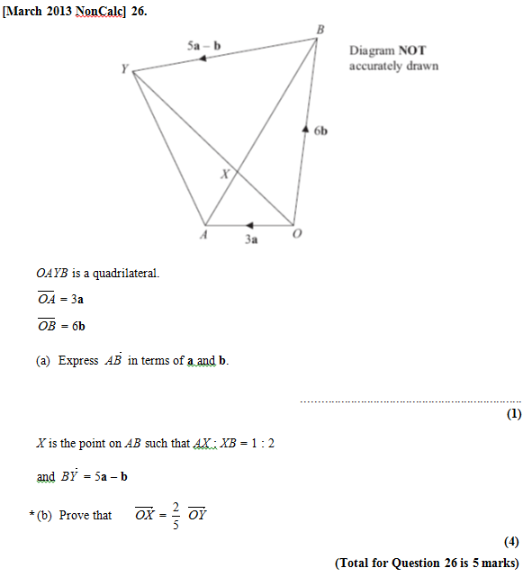
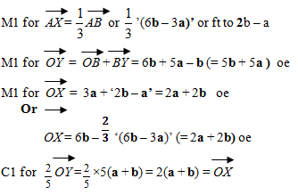
Vectors
<< Return to Index
?
?

Slide 27
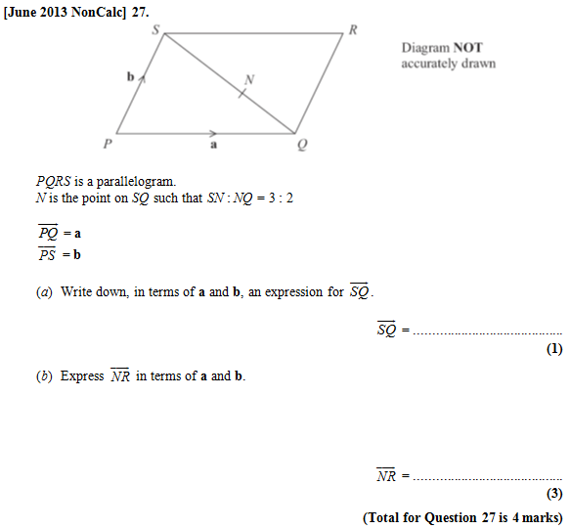
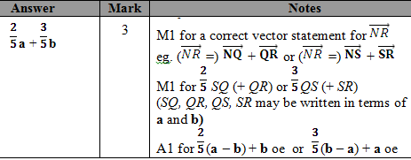
Vectors
<< Return to Index
?
?

Slide 28
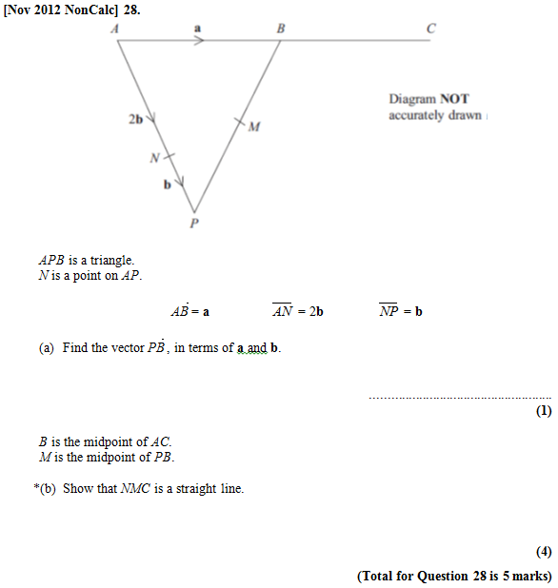
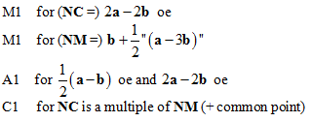
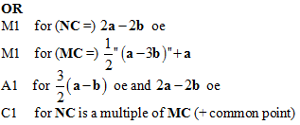
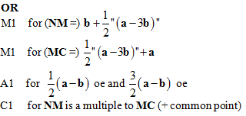
Vectors
<< Return to Index
?
?

Slide 29
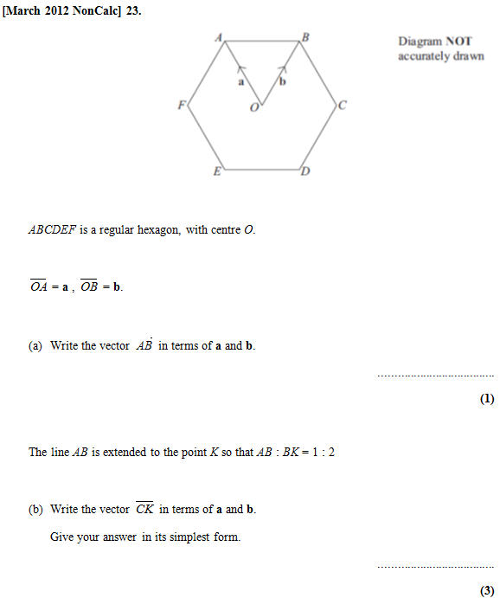
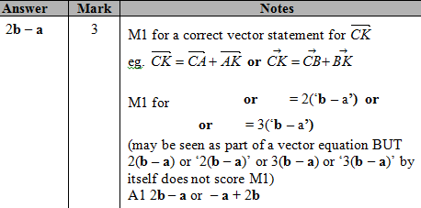
Vectors
<< Return to Index
?
?

Slide 30
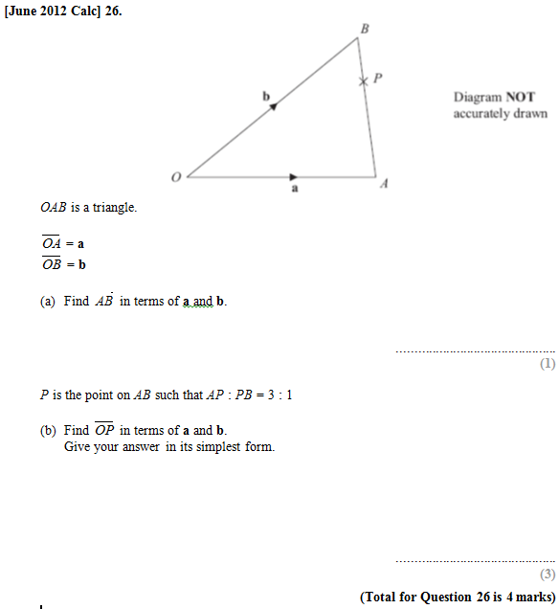
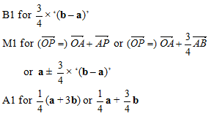
Vectors
<< Return to Index
?
?

Slide 31
Vectors
<< Return to Index
?
?

Slide 32
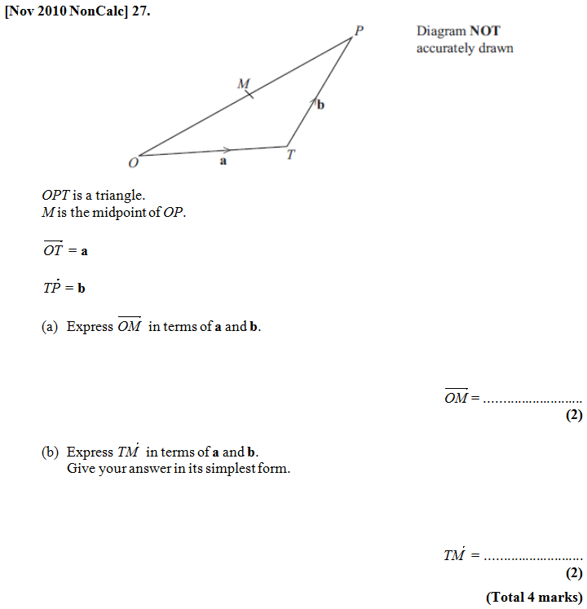
Vectors
<< Return to Index
?
?

Slide 33
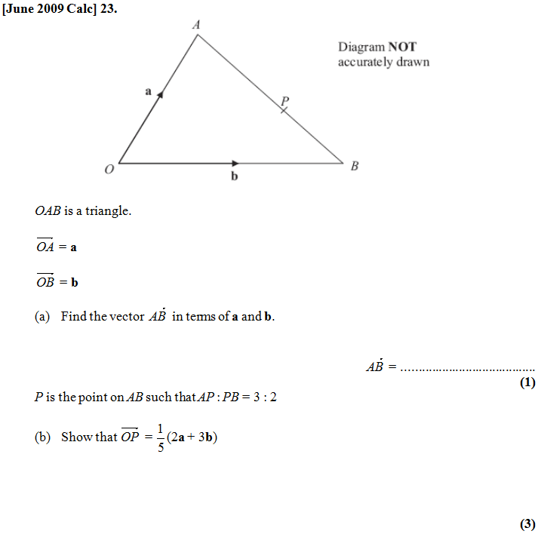
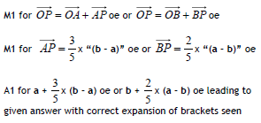
Vectors
<< Return to Index
?
?

