Slide 1

GCSE: Volumes and Surface Area
Dr J Frost (jfrost@tiffin.kingston.sch.uk)
www.drfrostmaths.com
GCSE Revision Pack Reference: 132, 133, 134, 135, 136i, 136ii, 138
Last modified: 31st August 2015

Slide 2
GCSE Specification
132. Know and use formulae to calculate the surface areas and volumes of cuboids and right-prisms.
133. Find the volume of a cylinder and surface area of a cylinder.
134. Find the surface area and volume of cones, spheres and hemispheres.
135. Find the volume of a pyramid.
136i. Solve a range of problems involving surface area and volume, e.g. given the volume and length of a cylinder find the radius.
136ii. Solve problems in which the surface area or volume of two shapes is equated.
138. Solve problems involving more complex shapes and solids, including (segments of circles and) frustums of cones.

Slide 3
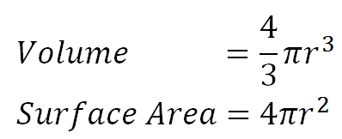
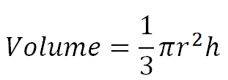
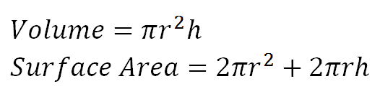
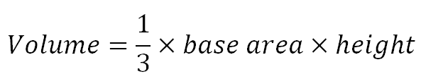
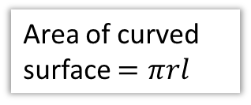
All the GCSE formulae for 3D shapes
! Don’t write these down yet.
(The * indicates ones that won’t be in your formula booklet)
r
r
l
h
r
?
?
?
?
?
*
Area of curved surface $=πrl$
Bro Tip: ‘Roll out’ the cylinder to work out the area of the curved surface.
?
?
*
h
Bro Tip: The same formula applies to the cone.

Slide 4


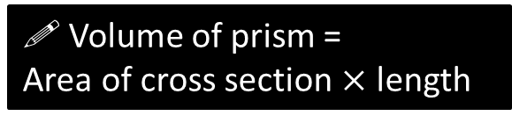
SKILL #1: Volumes of Prisms
! Volume of prism =
Area of cross section $×$ length
?
$$A$$
$$l$$

Slide 5
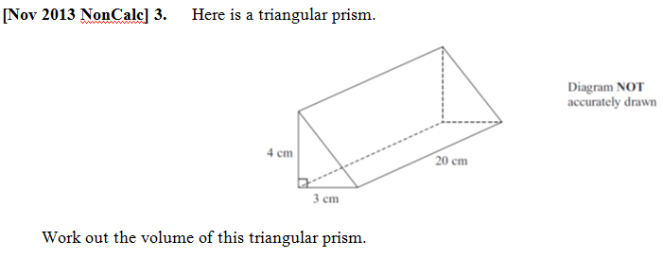
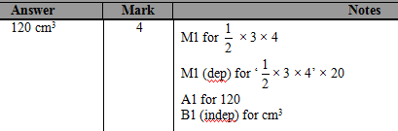
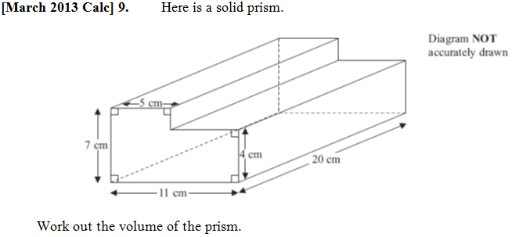
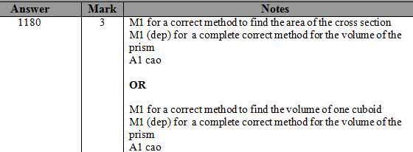
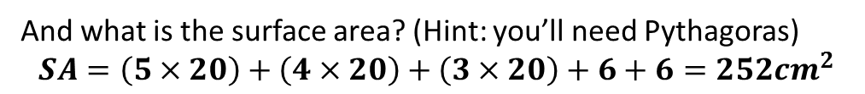
Test Your Understanding
?
And what is the surface area? (Hint: you’ll need Pythagoras)
$$SA=\left(5×20\right)+\left(4×20\right)+\left(3×20\right)+6+6=252cm^{2}$$
?
?

Slide 6


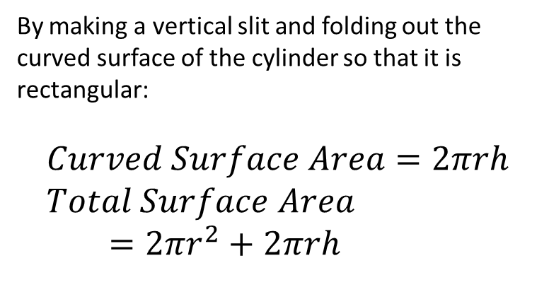
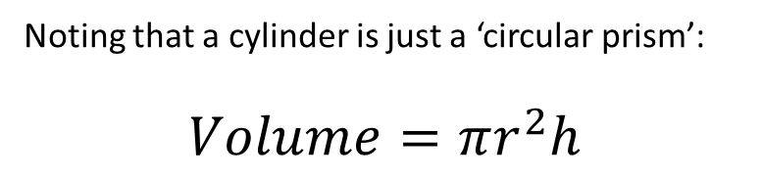
SKILL #2: Volumes of Cylinders
$$r$$
Noting that a cylinder is just a ‘circular prism’:
$$Volume=πr^{2}h$$
?
$$h$$
By making a vertical slit and folding out the curved surface of the cylinder so that it is rectangular:
$$Curved Surface Area=2πrh \\ Total Surface Area \\ =2πr^{2}+2πrh$$
?
?

Slide 7

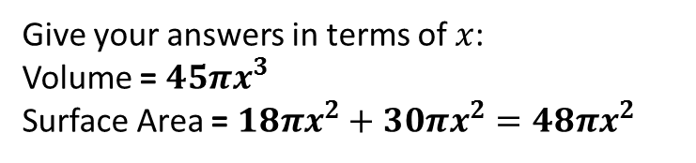



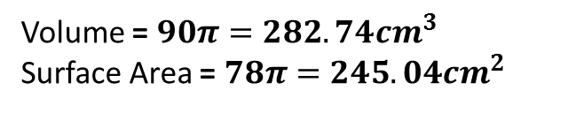
Test Your Understanding
$$3cm$$
?
Volume = $90π=282.74cm^{3}$
Surface Area = $78π=245.04cm^{2}$
?
$$10cm$$
$$6x$$
Give your answers in terms of $x$:
Volume = $45πx^{3}$
Surface Area = $18πx^{2}+30πx^{2}=48πx^{2}$
$$5x$$
?
?

Slide 8
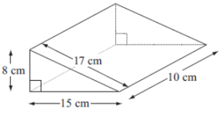
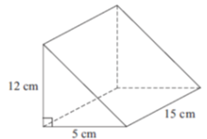
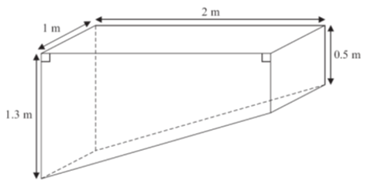









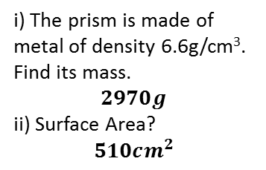



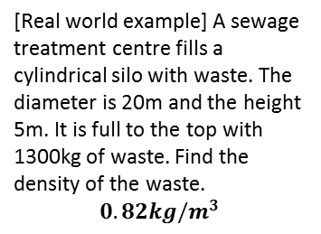
Exercise 1
$$10cm$$
1
2
3
4
$$2cm$$
$$6cm$$
$$4cm$$
$$4cm$$
?
$$8cm$$
$$SA=520cm^{2}$$
$$V=600cm^{3}$$
i) The prism is made of metal of density 6.6g/cm³. Find its mass.
$$2970g$$
ii) Surface Area?
$$510cm^{2}$$
$$7cm$$
$$V=40π=125.66cm^{3} \\ SA=48π=150.80cm^{2}$$
?
?
$$V=272cm^{3}$$
?
?
?
?
7
$$7cm$$
5
6
^{To} Ali ^{From} Santa
$$20cm$$
POO
[Real world example] A sewage treatment centre fills a cylindrical silo with waste. The diameter is 20m and the height 5m. It is full to the top with 1300kg of waste. Find the density of the waste.
$$0.82kg/m^{3}$$
Santa wants to wrap a cylindrical present for Ali, with dimensions as shown above. It costs 0.24p per cm² of wrapping paper. Determine the cost to wrap the present.
£2.85
[Edexcel] The pond is completely full of water. Sumeet wants to empty the pond so he can clean it. Sumeet uses a pump to empty the pond. The volume of water in the pond decreases at a constant rate. The level of the water in the pond goes down by 20cm in the first 30 minutes. Work out how much more time Sumeet has to wait for the pump to empty the pond completely. (6 marks)
0.4m³ emptied in first 30 minutes. So 0.8m³ emptied per hour.
Total volume = 1.8m³
$$1.8÷0.8=2\frac{1}{4}hrs \\ 2\frac{1}{4}−\frac{1}{2}=1\frac{3}{4}hrs=1hr 45mins$$
?
?
?

Slide 9
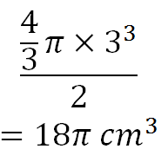
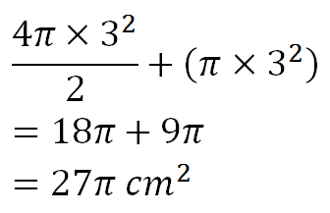
SKILL #3: Spheres and Hemispheres
Give your answers in terms of π.
Volume =
?
3cm
?
Surface Area =
For a Sphere:
?
?
(from formula sheet)

Slide 10
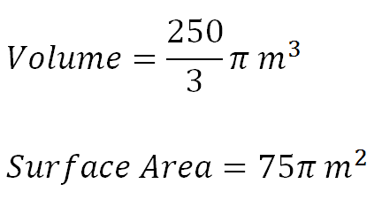
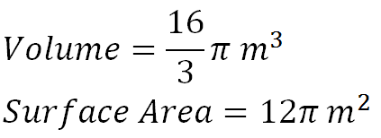

Test Your Understanding
Leave your answers in terms of $π$.
2m
10m
?
?
?
?

Slide 11
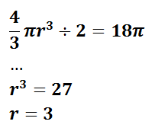
Exercise 2
Give your answers in terms of $π$ unless where specified.
1
2
Mr Wutang and his clan eat from a full (thin) hemispherical bowl of rice, a bowl with diameter 18cm. He eats 400g. What is the density of the rice to 3sf? (in g/cm³)
Volume = 486π
Density = 400 / 486π
= 0.262g/cm³
3
42m
6
?
Volume = 6174π m³
Surface Area = 1764π m²
Volume = 144π
Surface Area = 108π
?
?
?
?
4
18cm
6cm
A hemispherical bowl with radius 18cm, with a rim of width 6cm.
Volume
= 3888π – 1152π
= 2736π
Surface Area
= 1296π + 324π – 144π
= 1476π
5
What radius is needed for a hemisphere so that the volume is 18π m³?
?
?
?

Slide 12
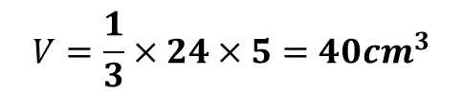
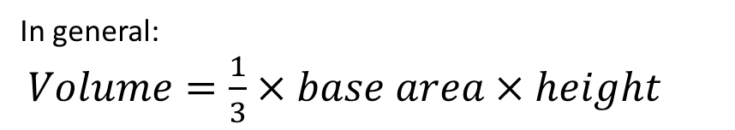



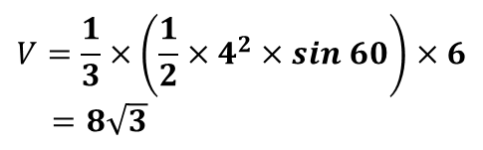




SKILL #4: Volumes of Pyramids
In general:
$Volume=\frac{1}{3}×base area×height$
?
$$h$$
$$A$$
Bro Exam Tip: This one is not given in the formula booklet!
?
Quickfire examples:
$$V=\frac{1}{3}×\left(\frac{1}{2}×4^{2}×sin 60\right)×6$$ $=8\sqrt{3}$
?
$$V=\frac{1}{3}×24×5=40cm^{3}$$
$$5cm$$
$$6$$
$$4cm$$
$$6cm$$
$$4$$

Slide 13
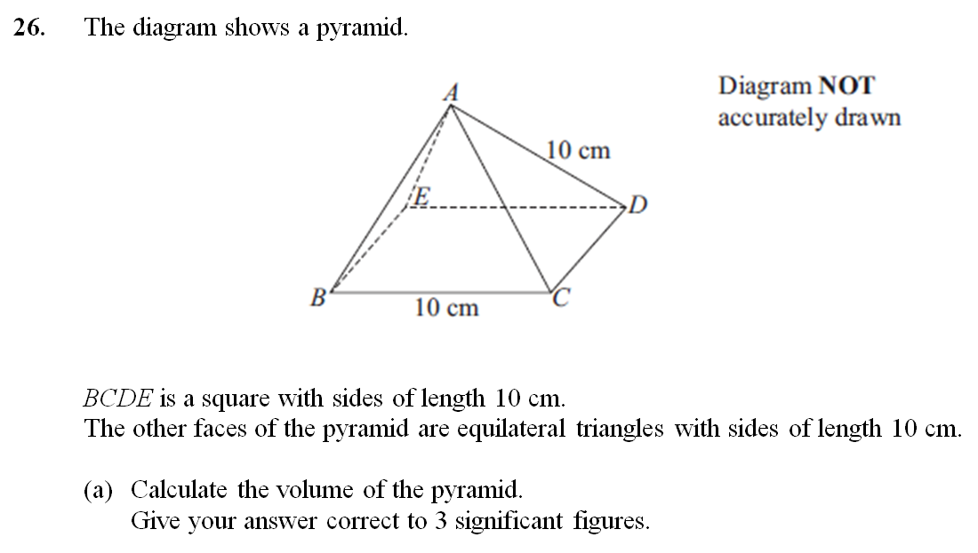
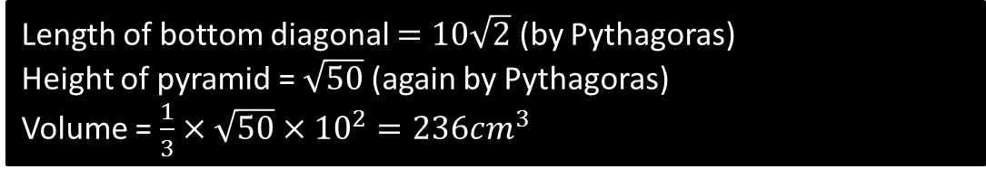
A* Question
√50
5√2
Length of bottom diagonal $=10\sqrt{2}$ (by Pythagoras)
Height of pyramid = $\sqrt{50}$ (again by Pythagoras)
Volume = $\frac{1}{3}×\sqrt{50}×{10}^{2}=236cm^{3}$
?
?
?

Slide 14





Test Your Understanding
Q
Volume ?
$$8cm$$
$$Base diagonal=\sqrt{8^{2}+8^{2}}=8\sqrt{2} cm \\ Half base diagonal=4\sqrt{2} cm \\ Height=\sqrt{8^{2}−{\left(4\sqrt{2}\right)}^{2}}=\sqrt{32}=4\sqrt{2} cm \\ Volume=\frac{1}{3}×8^{2}×4\sqrt{2}=120.68cm^{3}$$
$$8cm$$
$$8cm$$
Q
Determine the volume of a pyramid with a rectangular base of width 6cm and length 8cm, and a slant height of 13cm (your answer should turn out to be a whole number).
$$Base diagonal=\sqrt{6^{2}+8^{2}}=10cm \\ Half base diagonal=5cm \\ Height=\sqrt{{13}^{2}−5^{2}}=12cm \\ Volume=\frac{1}{3}×\left(6×8\right)×12=192cm^{3}$$
?

Slide 15

















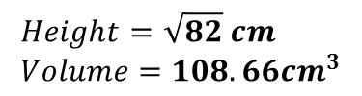







Exercise 3
1
2
3
$$9km$$
$$6cm$$
$$1km$$
$$1m$$
$$1m$$
$$4cm$$
$$1km$$
$$1km$$
$$1km$$
$$1m$$
$$4cm$$
$$1km$$
?
$$1km$$
?
$$Volume=32cm^{3}$$
?
$$Volume=\frac{1}{6}m^{3}$$
$$Volume=15km^{3}$$
The implication is that if we chop a cube across its face diagonals, we have something 6 times as small.
4
5
$$10cm$$
$$1cm$$
$$B$$
6
$$85cm$$
$$6cm$$
$$1cm$$
$$1cm$$
$$C$$
$$6cm$$
$$24cm$$
?
$$Height=\frac{\sqrt{2}}{2} cm \\ Volume=\frac{\sqrt{2}}{6} cm^{3}$$
$$A$$
$$Height=\sqrt{82} cm \\ Volume=108.66cm^{3}$$
?
$$10cm$$
?
?
$$Height=84cm \\ Volume=6720 cm^{3} \\ ∠ABC=17.6°$$
?
?
?

Slide 16
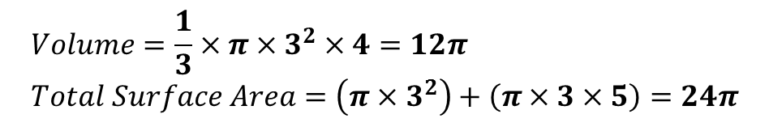

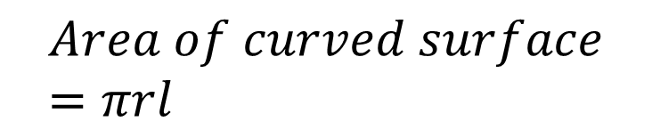


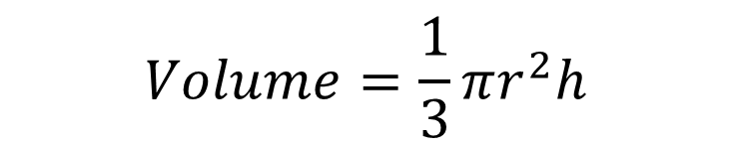

SKILL #4: Cones and Frustums
Noting that a cone is just a circular-based pyramid:
?
$$Volume=\frac{1}{3}πr^{2}h$$
$$l$$
$$h$$
$$Area of curved surface=πrl$$
$$r$$
?
(where $l$ is the slant height)
Example
$$Volume=\frac{1}{3}×π×3^{2}×4=12π \\ Total Surface Area=\left(π×3^{2}\right)+\left(π×3×5\right)=24π$$
?
4
?
3

Slide 17
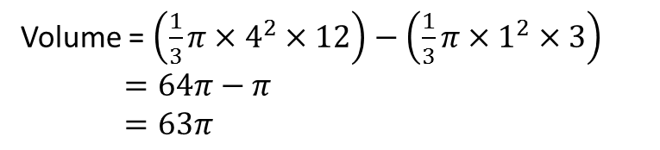
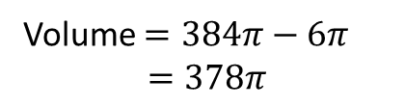
Frustum
! A frustum is a cone with part of the top chopped off.
1
Volume = $\left(\frac{1}{3}π×4^{2}×12\right)−\left(\frac{1}{3}π×1^{2}×3\right)$
$=64π−π$
$=63π$
12
?
9
4
Your Go...
Volume $=384π−6π$
$=378π$
?
2
(Hint: you’ll need to work out the radius of the top circle, perhaps by similar triangles?)
For a Cone:
8
12

Slide 18


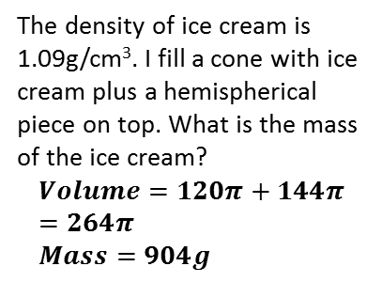
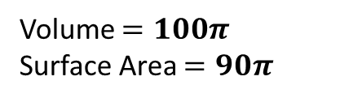


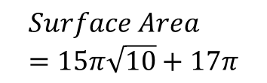
Exercise 4
1
2
3
3
12
8
12
4
5
Volume $=100π$
Surface Area $=90π$
?
12
?
$$Volume=63π$$
?
Volume = 96π
Surface Area = 96π
?
?
6
4
3
The density of ice cream is 1.09g/cm³. I fill a cone with ice cream plus a hemispherical piece on top. What is the mass of the ice cream?
$$Volume=120π+144π=264π \\ Mass=904g$$
5
8
12
5
6
4
$$10cm$$
?
$$Volume=144π−\frac{81}{16}π=\frac{2223}{16}π$$
?
$$Surface Area \\ =15π\sqrt{10}+17π$$
$$6cm$$
?

Slide 19



SKILL #5: Finding values of variables
Sometimes the volume and surface area is already given, and you need to find the value of some variable, e.g. radius or height.
Example
A cylinder has a height of 10m and a volume of $100m^{3}$. What is its radius?
$$π×r^{2}×10=100 \\ r^{2}=\frac{100}{10π}=\frac{10}{π} \\ r=\sqrt{\frac{10}{π}}=1.78m$$
$$r$$
$$10m$$
?

Slide 20
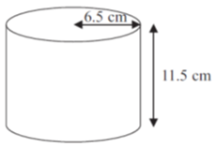


Check Your Understanding
Q
[Edexcel] A dog tin is cylindrical in shape with the indicated lengths. The manufacturer wants to make a new tin with the same volume but a radius of 5.8cm. What height should they make the tin?
$$π×{6.5}^{2}×11.5=π×{5.8}^{2}×h \\ h=\frac{{6.5}^{2}×11.5}{{5.8}^{2}}=14.4cm$$
?
Q
The Earth has a volume of $1.08×{10}^{12}km^{3}$
What is the radius of the Earth?
$$\frac{4}{3}πr^{3}=1.08×{10}^{12} \\ r=\sqrt[3]{\frac{1.08×{10}^{12}}{\frac{4}{3}π}}=6365km$$
?

Slide 21

























Exercise 5
$$10m$$
2
3
4
1
$$r$$
$$h$$
$$5m$$
$$r$$
$$r$$
$$V=1520m^{3}$$
$$V=20m^{3}$$
$$V=100m^{3}$$
$$SA=100m^{2}$$
?
?
?
?
$$h=4.84m$$
$$r=1.13m$$
$$r=2.88m$$
$$r=2.82m$$
5
$$V=720cm^{3}$$
6
7
$$SA=75π$$
$$10cm$$
$$2x$$
$$x$$
$$x$$
$$x$$
$$SA=27π$$
?
?
$$x=5$$
$$x=6\sqrt{6}=14.7cm$$
$$x$$
?
$$x=3$$

Slide 22


SKILL #6: Preserved volume or surface area
3km
“That ain’t no moon Chewie”
Darth Vader decides he doesn’t like the shape of his Death Star, so melts it down and rebuilds it using the same amount of material to form a Death Cube.
What is the side length x of his Death Cube?
$$\frac{4}{3}π×3^{3}=x^{3} \\ 36π=x^{3} \\ x=\sqrt[3]{36π}$$
?
Bro Tip: Find the volume of each, equate them, then simplify.

Slide 23


Further Example
?

Slide 24








Check Your Understanding
$$x$$
$$h$$
$$x$$
Sphere melted to form cone. Express $h$ in terms of $x$.
$$\frac{4}{3}πx^{3}=\frac{1}{3}πx^{2}h → \frac{4}{3}x=\frac{1}{3}h → 4x=h$$
?
$$x$$
This time the surface areas are the same (and should be equated before simplifying)
$$x$$
$$h$$
A solid hemisphere with radius $x$ has the same surface area as a cylinder with radius $x$ and height $h$. Determine the height of the cylinder in terms of $x$.
$$2πx^{2}+πx^{2}=2πx^{2}+2πxh → πx^{2}=2πxh \\ x=2h$$
?

Slide 25




Exercise 6
1
A sphere with radius $r$ is melted to form a cylinder of radius $r$ and height $h$. Determine $h$ in terms of $r$.
$$\frac{4}{3}πr^{3}=πr^{2}h \\ \frac{4}{3}r=h$$
A squared-based pyramid with base of side $x$ and height $h$ is melted to form a cube of side $2x$. Determine $h$ in terms of $x$.
$$\frac{1}{3}x^{2}h={\left(2x\right)}^{3}=8x^{3} \\ h=24x$$
A hemisphere of radius $2x$ is melted to form a cone of radius $x$ and height $2h$. Determine $h$ in terms of $x$.
$$\frac{2}{3}π{\left(2x\right)}^{3}=\frac{1}{3}πx^{2}\left(2h\right) \\ \frac{16}{3}πx^{3}=\frac{2}{3}πx^{2}h \\ 16x^{3}=2x^{2}h \\ h=8x$$
4
A sphere with radius $3x$ has the same surface area as a cylinder with radius $2x$ and height $h$. Find $h$ in terms of $x$.
$$4π{\left(3x\right)}^{2}=2π{\left(2x\right)}^{2}+2π\left(2x\right)h \\ 36πx^{2}=8πx^{2}+4πxh \\ 28πx^{2}=4πxh → h=7x$$
?
?
2
5
[Edexcel] Pictured are a solid cone and a solid hemisphere. The surface area of the cone is equal to the surface area of the hemisphere. Express $h$ in terms of $x$.” (Hint: you’ll need Pythag to find slant height)
$$l=\sqrt{x^{2}+h^{2}} \\ πx^{2}+πx\sqrt{x^{2}+h^{2}}=πx^{2}+2πx^{2} \\ πx\sqrt{x^{2}+h^{2}}=2πx^{2} \\ \sqrt{x^{2}+h^{2}}=2x → x^{2}+h^{2}=4x^{2} \\ h=\sqrt{3} x$$
?
?
3
?

Slide 26
GCSE Specification
132. Know and use formulae to calculate the surface areas and volumes of cuboids and right-prisms.
133. Find the volume of a cylinder and surface area of a cylinder.
134. Find the surface area and volume of cones, spheres and hemispheres.
135. Find the volume of a pyramid.
136i. Solve a range of problems involving surface area and volume, e.g. given the volume and length of a cylinder find the radius.
136ii. Solve problems in which the surface area or volume of two shapes is equated.
138. Solve problems involving more complex shapes and solids, including (segments of circles and) frustums of cones.

