Slide 1
Year 8 Equations with Fractions
Dr J Frost (jfrost@tiffin.kingston.sch.uk)
Last modified: 23rd March 2014

Slide 2
RECAP: Solving Linear Equations
Help Gary find the crumpet by solving the following linear equations.
5a + 7 = 42
a = 7
GARY
?
5x + 3 = 3x – 5
x = -4
?
1 – 2x = 8
x = -7/2
?
2(3 + 4x) = 6 – 4x
x = 0
?
Nom
x + 1 = x + 2
No solution
?

Slide 3
Exercise 1
1
Solve the following equations:
(leave your answers as fractions where appropriate)
5x – 1 = 49 x = 10
2x + 5 = 1 x = -2
1 – x = 10 x = -9
9x – 3 = -15 x = -4/3
9 – 6x = 7 x = 1/3
3
Solve the following equations (or else):
2(x + 1) = 4 x = 1
5(x – 3) = 15x + 5 x = -2
1 + 3(2x + 4) = 9x + 4 x = 3
5(3 – 4y) = 1 + 2(y + 1) y = 6/11
1 – 2(x – 4) = 3x x = 9/5
x + 2x(3 + x) = 2x² - 3 x = -3/7
?
?
?
?
?
?
?
?
?
?
?
2
Solve the following equations:
2x – 1 = x + 1 x = 2
9x – 1 = 6x + 4 x = 5/3
7y + 1 = 9y + 6 y = -5/2
1 – 8z = 2 – 5z z = -1/3
4 – 5z = 3 – 2z z = 1/3
4x + 5 = 2 – 3x x = -3/7
?
?
?
?
?
?

Slide 4
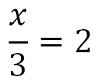
Equations with Fractions
We previously saw that we can do the ‘opposite’ of an operation to ‘cancel it out’, e.g. If 2x = 6, we divided by 2 to cancel out the “times 2” on the x.
× 3
?
?

Slide 5
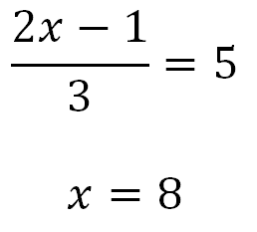
Example
?
(First times both sides by 3, then solve as normal)

Slide 6
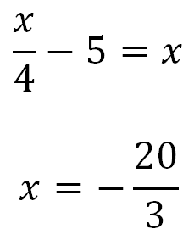
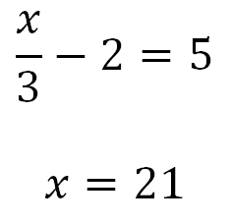
Examples
?
?
(First add 2 to both sides, then times both sides by 3)
Add 5 to both sides.
Then times both sides by 4 to get x = 4x + 20. (But we could have done these two steps the other way around)
Then solve as normal.

Slide 7
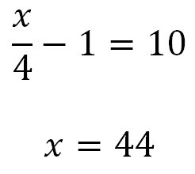
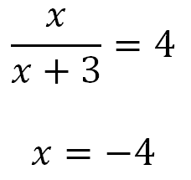
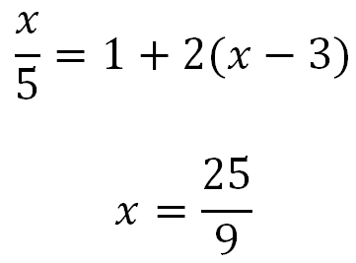
Test Your Understanding
1
1
?
?
3
Bro Tip: In general, when solving an equation, we should multiply by the denominator of any fraction, so that we no longer have any fractions lurking about.
?

Slide 8
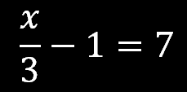
(Vote with your diaries) Solve for x.
18
21
24
27

Slide 9
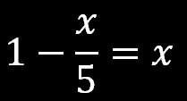
(Vote with your diaries) Solve for x.
5/6
6/5
10/7
10/6

Slide 10
(Vote with your diaries) Solve for x.
40/9
45/9
50/9
55/9

Slide 11
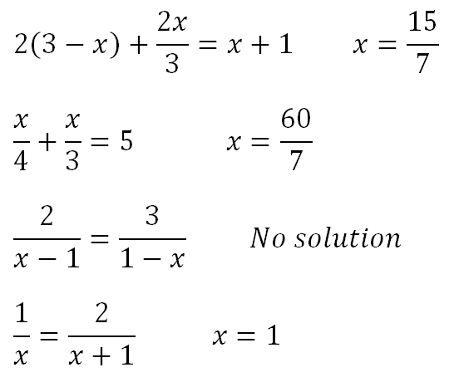
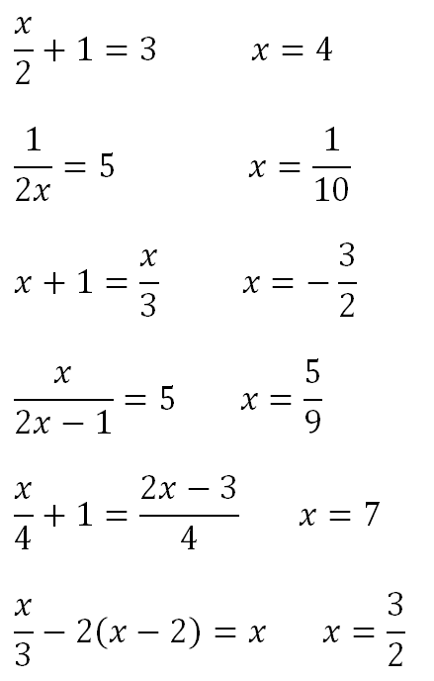
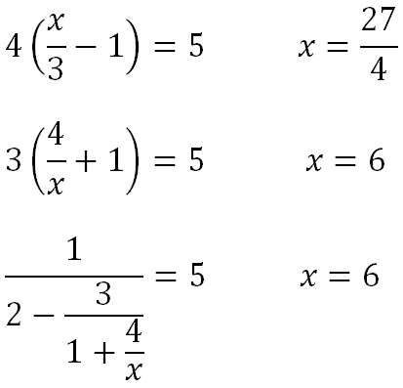
Exercises
Solve the following equations for x.
?
7
1
?
8
?
?
?
2
9
?
?
3
10
?
?
4
11
?
5
12
?
?
?
6
N

